Slide 1
Artificial Intelligence
Nik Bear Brown
nikbearbrown@gmail.com

Slide 2
Topics
Types of Game AI
Probabilistic Analysis
Pattern Matching
Markov Chains
Finite State Machines
Expert Systems
Adversarial Search and Game Playing
Algorithms for search
BFS, DFS, Dijkstra, MSTs (Prim & Kruskal), Bellman-Ford
Data Structures for search
Search and the Game of Othello
Alpha-Beta Pruning
A*
Expert & Knowledge-Based Systems
Fuzzy Logic
Neural Networks
Genetic Algorithms
Emergent Behavior (flocking)
Artificial Life (A-Life)

Slide 3
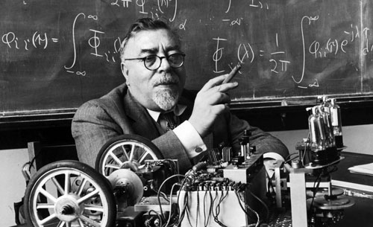
The Beginnings of A.I.
Norbert Wiener (November 26, 1894 – March 18, 1964) was an American mathematician and philosopher. He was professor of mathematics at MIT.
Wiener is considered the originator of cybernetics, a formalization of the notion of feedback.
What was so important about his research into feedback loops was that Wiener theorized that all intelligent behavior was the result of feedback mechanisms. Mechanisms that could possibly be simulated by machines. This discovery influenced much of early development of AI.

Slide 4
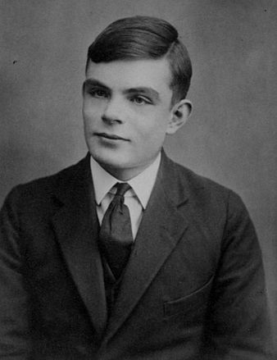
Alan Turing
In 1950 Alan Turing published a landmark paper in which he speculated about the possibility of creating machines with true intelligence. He noted that "intelligence" is difficult to define and devised his famous Turing Test. If a machine could carry on a conversation (over a teletype) that was indistinguishable from a conversation with a human being, then the machine could be called "intelligent."

Slide 5

Turing Test
The Turing test is a test, developed by Alan Turing in 1950, of a machine's ability to exhibit intelligent behavior equivalent to, or indistinguishable from, that of a human.

Slide 6
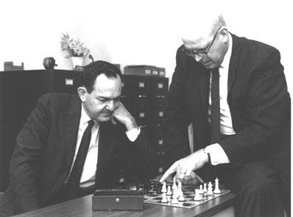
Allen Newell & Herbert Simon
In late 1955, Newell and Simon developed The Logic Theorist, considered by many to be the first AI program. The program, representing each problem as a tree model, would attempt to solve it by selecting the branch that would most likely result in the correct conclusion. The impact that the logic theorist made on both the public and the field of AI has made it a crucial stepping stone in developing the AI field.

Slide 7
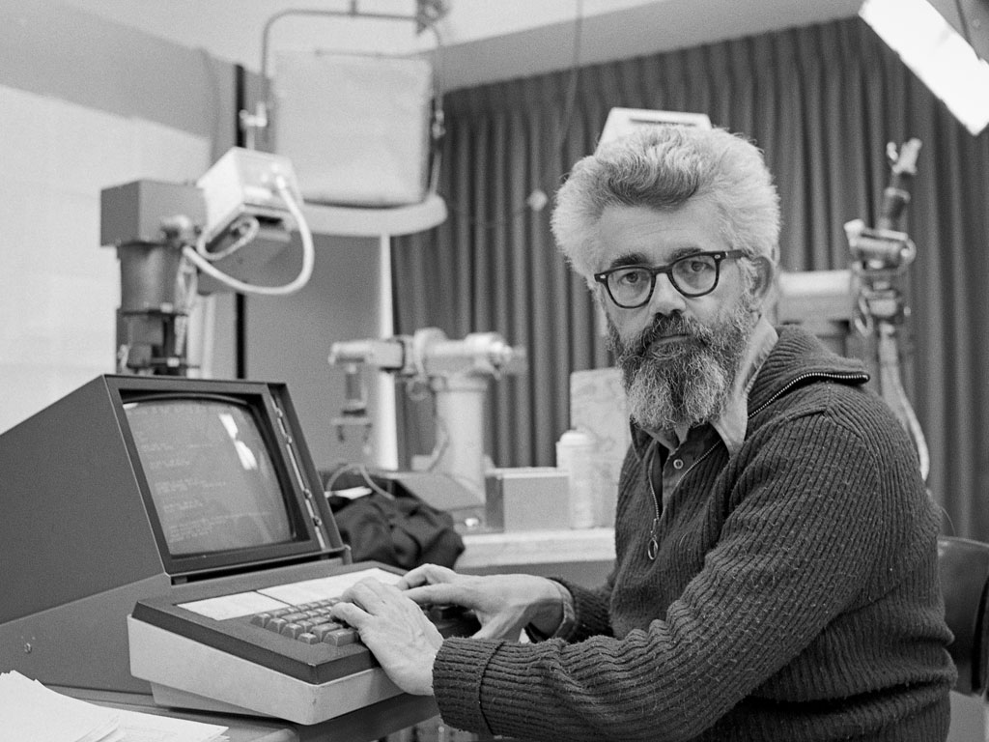
John McCarthy
In 1956 John McCarthy regarded as the father of AI, organized a conference to draw the talent and expertise of others interested in machine intelligence for a month of brainstorming. He invited them to Vermont for "The Dartmouth summer research project on artificial intelligence." From that point on, because of McCarthy, the field would be known as Artificial intelligence. Although not a huge success, the Dartmouth conference did bring together the founders in AI, and served to lay the groundwork for the future of AI research.

Slide 8
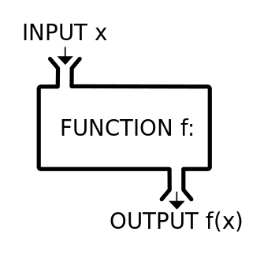
Models of Data
Start with data to predict new data

Slide 9
Learning from Data
Supervised Learning: each example has a label (discrete or continuous)
Reinforcement Learning: feedback after a sequence of actions/decisions
Unsupervised Learning: no feedback, goal is to group data into similar groups

Slide 10
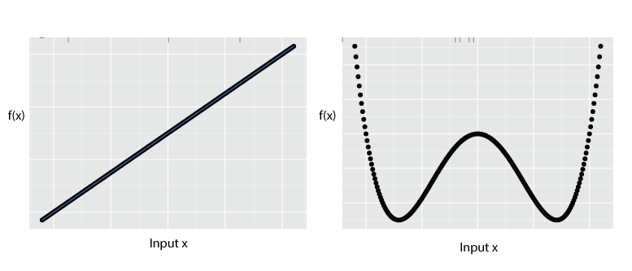
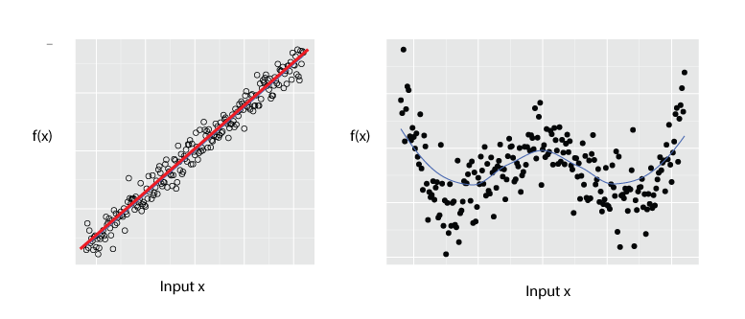
Models of Data

Slide 11
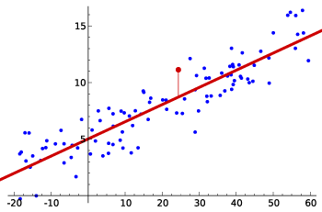
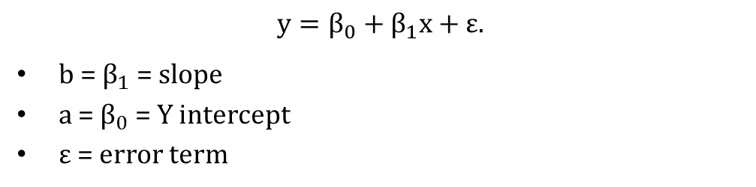
Modeling - Linear Models
$$y=β_{0}+β_{1}x+ε.$$
$b$ = $β_{1}$ = slope
$a$ = $β_{0}$ = $Y$ intercept
$ε$ = error term

Slide 12
Models of Systems
Linear and nonlinear
Static and dynamic
Deterministic and stochastic
Discrete and continuous
You can choose from several modeling environments, enabling you to describe your system programmatically, symbolically, or with block diagrams and state machines.

Slide 13
Models of Systems
Define the system and its components
Formulate the mathematical model and list the necessary assumptions
Write the equations or formal rules describing the model
Solve the equations for the desired output variables
Examine the solutions and the assumptions
If necessary, reanalyze or redesign the system

Slide 14
A.I. In Video Games
Video game artificial intelligence is a programming area that tries to make the computer act in a similar way to human intelligence.
A rule based system is used whereby information and rules are entered into a database, and when the video game AI is faced with a situation, it finds appropriate information and acts accordingly.

Slide 15
Types of Game AI
Logical AI - Automated playing of non-player opponents in games like chess
Movement AI - Movement: The manipulation of NPCs within the game universe;
Planning AI - Planning: The high-level control of behavioral threads within the game universe;
Interaction AI - Planning: The high-level control of behavioral threads within the game universe;
Environmental AI - Environmental: The appearance and objects of the game universe as manifested toward the player.
Statistical Analysis- One way to look at it is that statistical analysis takes observed probabilities, applies them to the evolving situation, and derives behavior.

Slide 16
Example – Enemies Track Players
Enemy (if in site) runs at player and attacks.
States:
- Wander or Search
- Spots and runs at player
- Track (get past obstacles) to get to player
- Fight (when in range of player)

Slide 17
Game Artificial Intelligence –Use cases
Games like Madden base their AI on an attempt to duplicate on the computer the coaching or managerial style of the selected celebrity.
Games have used bottom-up AI methods, such as the emergent behavior and evaluation of player actions in games like Creatures or Black & White
Logical rule based games like Chess, Jeopardy, Crossword, Scrabble, Sudoku, etc.
Pathfinding is the method for determining how to get a NPC from one point on a map to another, taking into consideration the terrain, obstacles and possibly "fog of war".
Video game combat AI
Procedural-content generation
Cheating AI and hints

Slide 18

Game Artificial Intelligence - Examples
Creatures (1996)
Creatures is an artificial life program where the user "hatches" small furry animals and teaches them how to behave. These "Norns" can talk, feed themselves, and protect themselves against vicious creatures. It's the first popular application of machine learning into an interactive simulation. Neural networks are used by the creatures to learn what to do. The game is regarded as a breakthrough in artificial life research, which aims to model the behavior of creatures interacting with their environment

Slide 19

Game Artificial Intelligence - Examples
Halo: Combat Evolved (2001)
A first-person shooter where the player assumes the role of the Master Chief, battling various aliens on foot or in vehicles. Enemies use cover very wisely, and employ suppressive fire and grenades. The squad situation affects the individuals, so certain enemies flee when their leader dies. A lot of attention is paid to the little details, with enemies notably throwing back grenades or team-members responding to you bothering them. The underlying "behavior tree" technology has become very popular in the games industry (especially since Halo 2)

Slide 20

Game Artificial Intelligence - Examples
F.E.A.R. (2005)
A first-person shooter where the player helps contain supernatural phenomenon and armies of cloned soldiers. The AI uses a planner to generate context-sensitive behaviors, the first time in a mainstream game. This technology used as a reference for many studios still today. The enemies are capable of using the environment very cleverly, finding cover behind tables, tipping bookshelves, opening doors, crashing through windows, and so on. Squad tactics are used to great effect. The enemies perform flanking maneuvers, use suppression fire, etc

Slide 21

Game Artificial Intelligence - Examples
S.T.A.L.K.E.R. series (2007-)
A first-person shooter survival horror game where the player must face man-made experiments, military soldiers, and mercenaries known as Stalkers. The various encountered enemies (if the difficulty level is set to its highest) use combat tactics and behaviours such as healing wounded allies, giving orders, out-flanking the player or using weapons with pinpoint accuracy

Slide 22

Game Artificial Intelligence - Examples
Far Cry 2 (2008)
A first-person shooter where the player fights off numerous mercenaries and assassinates faction leaders. The AI is behavior based and uses action selection, essential if an AI is to multitask or react to a situation. The AI can react in an unpredictable fashion in many situations. The enemies respond to sounds and visual distractions such as fire or nearby explosions and can be subject to investigate the hazard, the player can utilize these distractions to his own advantage. There are also social interfaces with an AI but however not in the form of direct conversation but more reactionary, if the player gets too close or even nudges an AI, the player is subject to getting shoved off or sworn at and by extent getting aimed at. Other social interfaces between AI exist when in combat, or neutral situations, if an enemy AI is injured on the ground, he will shout out for help, release emotional distress, etc.

Slide 23
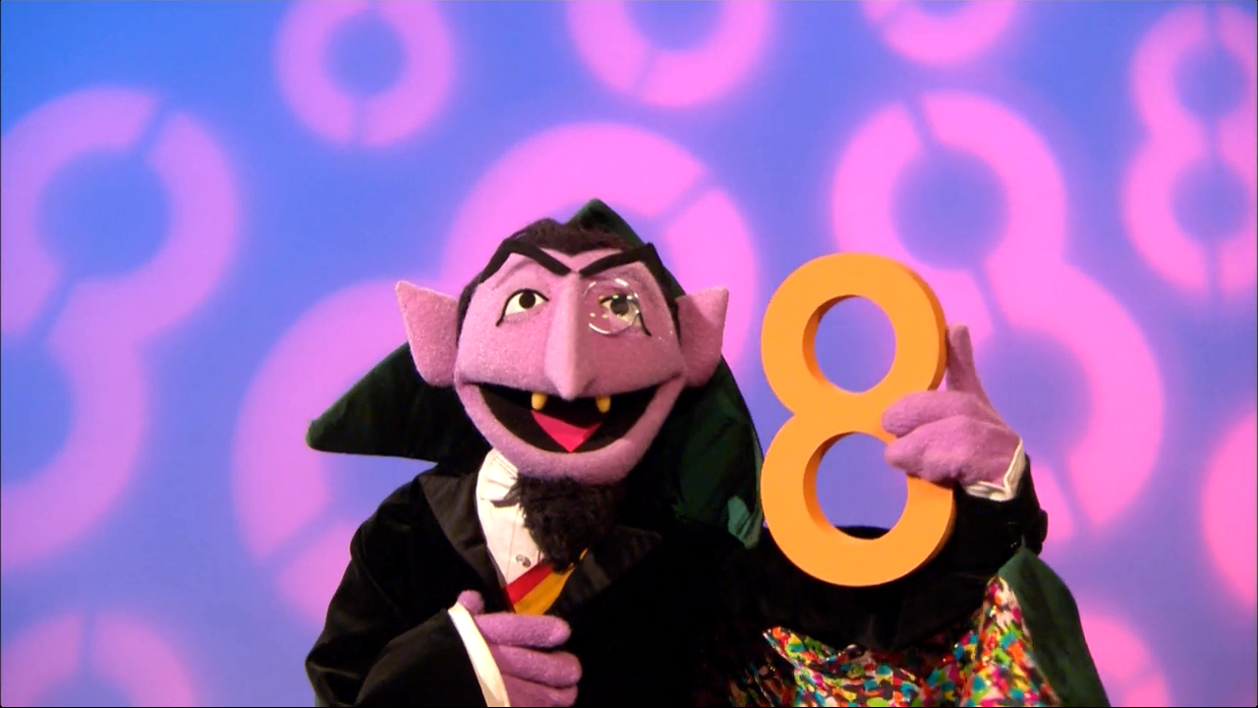
Probabilistic Analysis
Statistical Analysis- One way to look at it is that statistical analysis takes observed probabilities, applies them to the evolving situation, and derives behavior.

Slide 24
Probability
Probability is the measure of the likelihood that an event will occur.
0
1.0
0.5
The occurrence of the event is just as likely as it is unlikely

Slide 25
Probability
Probability is a measure of the likelihood of a random phenomenon or chance behavior. Probability describes the long-term proportion with which a certain outcome will occur in situations with short-term uncertainty.
Probability is expressed in numbers between 0 and 1. Probability = 0 means the event never happens; probability = 1 means it always happens.
The total probability of all possible event always sums to 1.

Slide 26
Probability
The probability of an event equals the number of times it happens divided by the number of opportunities.
These numbers can be determined by experiment or by knowledge of the system.
For instance, rolling a die (singular of dice). The chance of rolling a 2 is 1/6, because there is a 2 on one face and a total of 6 faces. So, assuming the die is balanced, a 2 will come up 1 time in 6.
It is also possible to determine probability by experiment: if the die were unbalanced (loaded = cheating), you could roll it hundreds or thousands of times to get the actual probability of getting a 2. For a fair die, the experimentally determined number should be quite close to 1/6, especially with many rolls.
0.5

Slide 27
Guessing Cards
Game. Shuffle a deck of n cards; turn them over one at a time; try to guess each card.
Memoryless guessing. No psychic abilities; can't even remember what's been turned over already. Guess a card from full deck uniformly at random.
Claim. The expected number of correct guesses is 1.
Pf. (surprisingly effortless using linearity of expectation)
Let X_{i} = 1 if i^{th} prediction is correct and 0 otherwise.
Let X = number of correct guesses = X₁ + … + X_{n}.
E[X_{i}] = Pr[X_{i} = 1] = 1/n.
E[X] = E[X₁] + … + E[X_{n}] = 1/n + … + 1/n = 1. ▪
linearity of expectation

Slide 28
Guessing Cards
Game. Shuffle a deck of n cards; turn them over one at a time; try to guess each card.
Guessing with memory. Guess a card uniformly at random from cards not yet seen.
Claim. The expected number of correct guesses is Θ(log n).
Pf.
Let X_{i} = 1 if i^{th} prediction is correct and 0 otherwise.
Let X = number of correct guesses = X₁ + … + X_{n}.
E[X_{i}] = Pr[X_{i} = 1] = 1 / (n - i - 1).
E[X] = E[X₁] + … + E[X_{n}] = 1/n + … + 1/2 + 1/1 = H(n). ▪
ln(n+1) < H(n) < 1 + ln n

Slide 29
Coupon Collector
Coupon collector. Each box of cereal contains a coupon. There are n different types of coupons. Assuming all boxes are equally likely to contain each coupon, how many boxes before you have ≥ 1 coupon of each type?
Claim. The expected number of steps is Θ(n log n).
Pf.
Phase j = time between j and j+1 distinct coupons.
Let X_{j} = number of steps you spend in phase j.
Let X = number of steps in total = X₀ + X₁ + … + X_{n-1}.
prob of success = (n-j)/n ⇒ expected waiting time = n/(n-j)

Slide 30
Permutations
A B C D E
How many ways can we choose 2 letters from the above 5, without replacement, when the order in which we choose the letters is important?
5 × 4 = 20

Slide 31
Permutations (cont.)

Slide 32
Combinations
A B C D E
How many ways can we choose 2 letters from the above 5, without replacement, when the order in which we choose the letters is not important?
5 × 4 = 20 when order important
Divide by 2: (5 × 4)/2 = 10 ways
N choose K (5 choose 2)

Slide 33
Bounding Numbers of Combinations
= number of (unordered) combinations of n objects taken k at a time
N choose K

Slide 34
Combinations (cont.)

Slide 35
Tail Bounds
In the analysis of randomized algorithms, we need to know how much does an algorithms run-time/cost deviate from its expected run-time/cost.
That is we need to find an upper bound on Pr[X deviates from E[X] a lot]. This we refer to as the tail bound on X.

Slide 36
Markov and Chebychev Inequalities
Markov Inequality (uses only mean)
Chebychev Inequality (uses mean and variance)

Slide 37
Markov and Chebychev Inequalities
Example, if B is a Binomial with parameters n,p

Slide 38
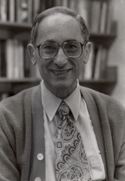
Chernoff bounds
The Chernoff bound for a random variable X is
obtained as follows: for any t >0,
Pr[X  a] = Pr[e^{tX}  e^{ta}] ≤ E[e^{tX} ] / e^{ta}
Similarly, for any t <0,
Pr[X  a] = Pr[e^{tX}  e^{ta}] ≤ E[e^{tX} ] / e^{ta}
The value of t that minimizes E[e^{tX} ] / e^{ta} gives the best possible bounds.

Slide 39
Chernoff Bounds for Binomial B with parameters n,p
Above mean x ≥ μ

Slide 40
Chernoff Bounds for Binomial B with parameters n,p
Below mean x ≤ μ

Slide 41
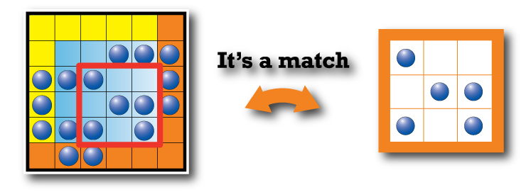
Pattern Matching
In computer science, pattern matching is the act of checking a given sequence of tokens for the presence of the constituents of somepattern. In contrast to pattern recognition, the match usually has to be exact. The patterns generally have the form of either sequences or tree structures.

Slide 42
Pattern Matching Algorithms
Naïve Approach
Compare pattern to text at each location.
O(mn) time.
More efficient algorithms utilize information from previous comparisons.
Boyer-Moore Algorithm
Knuth-Morris-Pratt’s algorithm

Slide 43
Markov Chains
A Markov chain (discrete-time Markov chain or DTMC), named after Andrey Markov, is a random process that undergoes transitions from one state to another on a state space. That is, a stochastic model describing a sequence of possible events in which the probability of each event depends only on the state attained in the previous event.

Slide 44
Discrete – Time Markov Chains
Many real-world systems contain uncertainty and
evolve over time.
Stochastic processes (and Markov chains)
are probability models for such systems.
A discrete-time stochastic process
is a sequence of random variables
X₀, X₁, X₂, . . . typically denoted by { X_{n} }.

Slide 45
Markov Chain Definition
A stochastic process { X_{n} } is called a Markov chain if
Pr{ X_{n+1} = j | X₀ = k₀, . . . , X_{n-1} = k_{n-1}, X_{n} = i }
= Pr{ X_{n+1} = j | X_{n} = i } ← transition probabilities
for every i, j, k₀, . . . , k_{n-1} and for every n.
Discrete time means n ∈ N = { 0, 1, 2, . . . }.
The future behavior of the system depends only on the
current state i and not on any of the previous states.

Slide 46
Stationary Transition Probabilities
Pr{ X_{n+1} = j | X_{n} = i } = Pr{ X₁ = j | X₀ = i } for all n
(They don’t change over time)
We will only consider stationary Markov chains.

Slide 47
Markov Process
• Markov Property: The state of the system at time t+1 depends only on the state of the system at time t
X₁
X₂
X₃
X₄
X₅
• Stationary Assumption: Transition probabilities are independent of time (t)

Slide 48
Markov Process - Simple Example
Weather:
raining today 40% rain tomorrow
60% no rain tomorrow
not raining today 20% rain tomorrow
80% no rain tomorrow
Stochastic FSM:
0.4
0.6
0.8
rain
no rain
0.2

Slide 49
Components of Stochastic Processes
The state space of a stochastic process is
the set of all values that the X_{n}’s can take.
(we will be concerned with
stochastic processes with a finite # of states )
Time: n = 0, 1, 2, . . .
State: v-dimensional vector, s = (s₁, s₂, . . . , s_{v})
In general, there are m states,
s¹, s², . . . , s^{m} or s⁰, s¹, . . . , s^{m-1}
Also, X_{n} takes one of m values, so X_{n} ↔ s.

Slide 50
n-Step Transition Probabilities
This idea generalizes to an arbitrary number of steps.
For n = 3: P⁽³⁾ = P⁽²⁾ P = P² P = P³
or more generally, P^{(n)} = P^{(m)} P^{(n-m)}
The ij th entry of this reduces to
p_{ij}^{(n)} = ∑ p_{ik}^{(m)} p_{kj}^{(n-m)} 1 ≤ m ≤ n−1
m
k =0
Chapman - Kolmogorov Equations
Interpretation:
RHS is the probability of going from i to k in m steps & then going from k to j in the remaining n − m steps, summed over all possible intermediate states k.

Slide 51
What You Should Know About Markov Chains
How to define states of a discrete time process.
How to construct a state-transition matrix.
How to find the n-step state-transition probabilities (using the Excel add-in).
How to determine the unconditional probabilities after n steps
How to determine steady-state probabilities (using the Excel add-in).

Slide 52
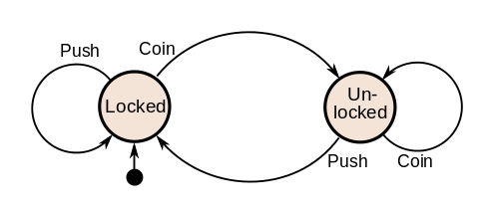
Finite State Machines
A finite-state machine (FSM) or finite-state automaton (plural: automata), or simply a state machine, is a mathematical model of computation used to design both computer programs and sequential logic circuits. It is conceived as an abstract machine that can be in one of a finite number of states.

Slide 53
Representing a Finite State Machine
It can also be represented using a state diagram which has the same information as the state transition diagram.
Input / Output
State₀
State₁
Input / Output

Slide 54
What is a state machine?
A state machine is a different way of thinking about computation
A state machine has some number of states, and transitions between those states
Transitions occur because of inputs
A “pure” state machine only knows which state it is in—it has no other memory or knowledge
This is the kind of state machine you learn about in your math classes
When you program a state machine, you don’t have that restriction

Slide 55
Example I: Even or odd
The following machine determines whether the number of As in a string is even or odd
Circles represent states; arrows represent transitions
A
even
odd
start
A
anything but A
anything but A

Slide 56
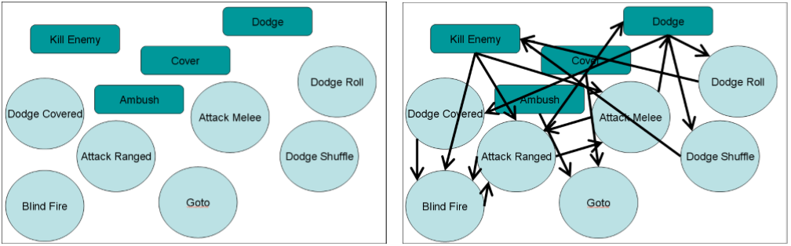
FSM – Finite State Machine
The AI of F.E.A.R. - http://alumni.media.mit.edu/~jorkin/gdc2006_orkin_jeff_fear.pdf
Planning System that constitute the Smart Object State
Construct all possible Plans
Find the best Plan using A*
Break the Plan into Actions
Animate each Action
Notes:
Explain the FSM of FEAR and how it uses A* to find the best path

Slide 57

Expert Systems
In artificial intelligence, an expert system is a computer system that emulates the decision-making ability of a human expert. Expert systems are designed to solve complex problems by reasoning about knowledge, represented primarily as if–then rules rather than through conventional procedural code.

Slide 58
Expert Systems
Knowledge-based system
Software that uses a specific set of information, from which it extracts and processes particular pieces
Expert system
A software system based the knowledge of human experts; it is a
Rule-based system
A software system based on a set of if-then rules
Inference engine
The software that processes rules to draw conclusions

Slide 59
Expert System Main Components
Knowledge base – obtainable from books, magazines, knowledgeable persons, etc.
Inference engine – draws conclusions from the knowledge base

Slide 60
Expert Systems - chatbots
A chatbot is a conversational agent that interacts with users using natural language.
Started as an attempt to fool humans.
Numerous applications of chatbots such as Customer Service, call centers etc

Slide 61
Chatbot History
ELIZA
Developed in the 1960s
Looks for pronouns and verbs
‘You’ becomes ‘I’ and vice versa
User: You are a dork.
ELIZA: What makes you think I am a dork?
PARRY (1972)‏
Simulated a paranoid schizophrenic

Slide 62
ELIZA
Pattern matching
One of the first chatterbots designed in 1966
Parodies a therapist rephrasing statements of the user and posing them back as questions
Works by simple parsing and substitution of key words into canned phrases
People get emotionally caught up by ELIZA’s confident replies forgetting that it’s a machine

Slide 63
Example of Conversation
Eliza’s conversation with a patient is:-
Human: Well, my boyfriend made me come here.
ELIZA: Your boyfriend made you come here?
Human: He says I'm depressed much of the time.
ELIZA: I am sorry to hear you are depressed.
Human: It's true. I'm unhappy.
ELIZA: Do you think coming here will help you not to be unhappy?
Able to elicit emotional responses from users though being programmed not to do so
Demonstrates ELIZA effect

Slide 64
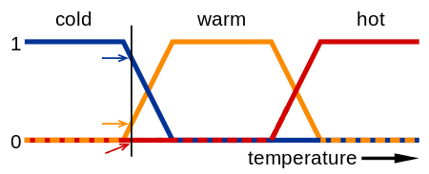
Fuzzy Logic
Fuzzy logic is an approach to computing based on "degrees of truth" rather than the usual "true or false" (1 or 0) Boolean logic on which the modern computer is based. The idea of fuzzy logic was first advanced by Dr. Lotfi Zadeh of the University of California at Berkeley in the 1960s.

Slide 65
Fuzzy Logic Example

Slide 66
Fuzzy Logic
1. Fuzzify all input values into fuzzy membership functions.
2. Execute all applicable rules in the rulebase to compute the fuzzy output functions.
3. De-fuzzify the fuzzy output functions to get "crisp" output values.

Slide 67
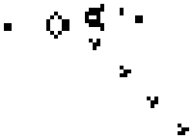
Agent Based Modeling (ABM)
An agent-based model (ABM) is one of a class of computational models for simulating the actions and interactions of autonomous agents
For example, The Game of Life, also known simply as Life, is acellular automaton devised by the British mathematician John Horton Conway in 1970.^{[1]}
The "game" is a zero-player game, meaning that its evolution is determined by its initial state, requiring no further input.

Slide 68
What is an agent?
First: What is an agent?
An entity that functions continuously and autonomously in an environment in which other processes take place and other agents exist (Shoham)
General Characteristics:
Autonomy
Pro-activeness
Reactivity
“Social” Ability
Notes:
autonomy: agents operate without direct intervention from the user, and have some sort of control over their actions
pro-activeness: agents not only react in response to the environment, but also exhibit goal-directed behavior
reactivity: agents perceive their environment and respond to changes
social ability: agents can interact with other agents

Slide 69
Why Use Agent Based Modeling (ABM)?
Captures Emergent Phenomena
As the components of a system interact with each other, and influence each other through these interactions, the system as a whole exhibits emergent behavior (Roetzheim)
This characteristic makes the output of a system difficult to understand and predict

Slide 70
Adversarial Search
How should you play against an opponent?
Games as search problems
Game has
initial state — configuration + player to move
successor function
terminal test — game over or not

Slide 71
Adversarial Search to play a game
A way to play such a game is to:
Consider all the legal moves you can make
Compute new position resulting from each move
Evaluate each to determine which is best
Make that move
Wait for your opponent to move and repeat
Key problems are:
Representing the “board”
Generating all legal next boards
Evaluating a position

Slide 72
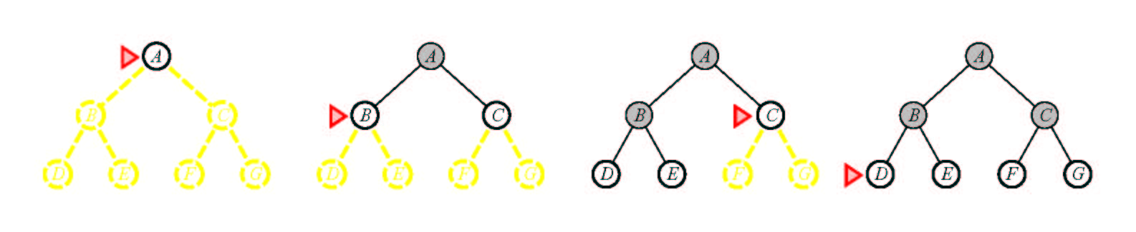
Breadth-First Search
Notes:
Suppose the solution is at depth 4 at the right. Then we must explore almost all paths of length 5 before we find it.
Suppose all paths of length 10 are solutions?
Note how much memory this approach takes.

Slide 73
Pseudocode for Breadth-First Search
Initialize: Let Q = {S}
While Q is not empty
pull Q1, the first element in Q
if Q1 is a goal
report(success) and quit
else
child_nodes = expand(Q1)
eliminate child_nodes which represent loops
put remaining child_nodes at the back of Q
end
Continue

Slide 74
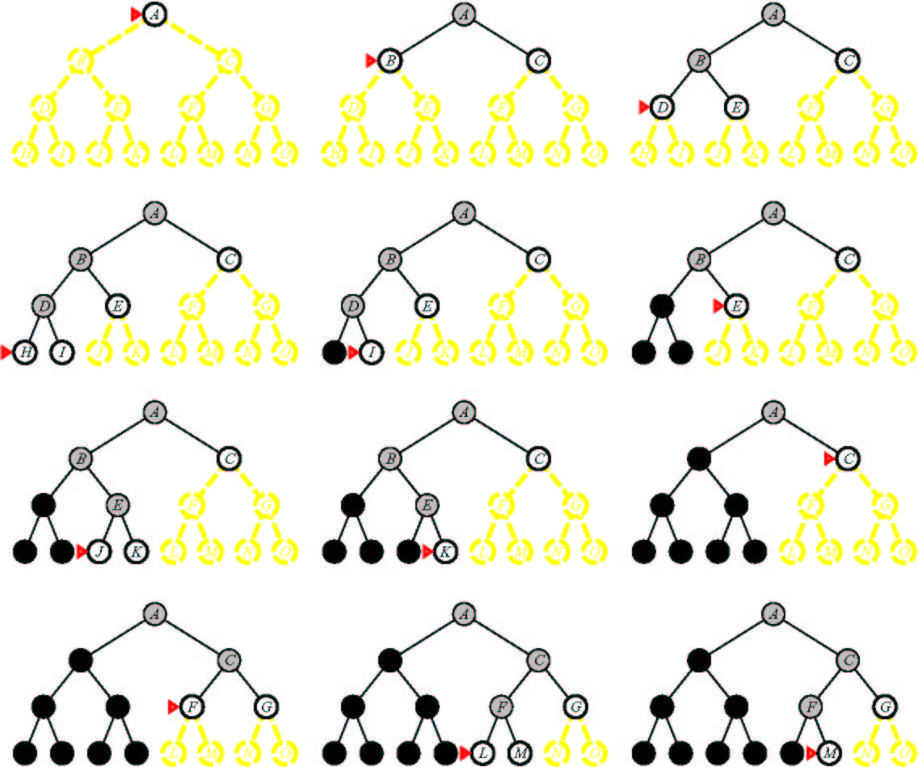
Depth-First Search
Notes:
Notice how much less memory this takes.
Note that we could have generated the answer but not noticed it.
Is depth-first search optimal? (I.e., if it finds the solution, it’s the best one) no. Can miss a better one somewhere else in the tree.
What’s the worst problem? Can go on forever. Can implement a cut off.

Slide 75
Depth First Search (DFS)
S
A
D
B
D
C
E
Here, to avoid repeated states assume we don’t expand any child node which appears already in the path from the root S to the parent. (Other strategies are also possible)
D
F
G

Slide 76
Pseudocode for Depth-First Search
Initialize: Let Q = {S}
While Q is not empty
pull Q1, the first element in Q
if Q1 is a goal
report(success) and quit
else
child_nodes = expand(Q1)
eliminate child_nodes which represent loops
put remaining child_nodes at the front of Q
end
Continue

Slide 77
Breadth First Search
S
A
D
B
A
D
E
C
E
E
S
B
S
B
F
(Use the simple heuristic of not generating a child node if that node is a parent to avoid “obvious” loops: this clearly does not avoid all loops and there are other ways to do this)

Slide 78
Comparing DFS and BFS
Same Time Complexity, unless...
say we have a search problem with
goals at some depth d
but paths without goals and which have infinite depth (i.e., loops in the search space)
in this case DFS never may never find a goal!
(it stays on an infinite (non-goal) path forever)
BFS does not have this problem
it will find the finite depth goals in time O(b^{d})
Practical considerations
if there are no infinite paths, and many possible goals in the search tree, DFS will work best
For large branching factors b, BFS may run out of memory
BFS is “safer” if we know there can be loops

Slide 79
Depth-Limited Search
This is Depth-first Search with a cutoff on the maximum depth of any path
i.e., implement the usual DFS algorithm
when any path gets to be of length m, then do not expand this path any further and backup
this will systematically explore a search tree of depth m
Properties of DLS
Time complexity = O(b^m), Space complexity = O(bm)
If goal state is within m steps from S:
DLS is complete
e.g., with N cities, we know that if there is a path to goal state G it can be of length N-1 at most
But usually we don’t know where the goal is!
if goal state is more than m steps from S, DLS is incomplete!
=> the big problem is how to choose the value of m

Slide 80
Iterative Deepening Search
Basic Idea:
we can run DFS with a maximum depth constraint, m
i.e., DFS algorithm but it backs-up at depth m
this avoids the problem of infinite paths
But how do we choose m in practice? say m < d (!!)
We can run DFS multiple times, gradually increasing m
this is known as Iterative Deepening Search
Procedure
for m = 1 to infinity
if (depth-first search with max-depth = m ) returns success
then report (success) and quit
else
continue
end

Slide 81
Iterative Deepening Search
Complexity
Space complexity = O(bd)
(since its like depth first search run different times)
Time Complexity
1 + (1+b) + (1 +b+b²) + .......(1 +b+....b^{d}) = O(b^{d}) (i.e., the same as BFS or DFS in the the worst case)
The overhead in repeated searching of the same subtrees is small relative to the overall time
e.g., for b=10, only takes about 11% more time than DFS
A useful practical method
combines
guarantee of finding a solution if one exists (as in BFS)
space efficiency, O(bd) of DFS

Slide 82
Bidirectional Search
Idea
simultaneously search forward from S and backwards from G
stop when both “meet in the middle”
need to keep track of the intersection of 2 open sets of nodes
What does searching backwards from G mean
need a way to specify the predecessors of G
this can be difficult,
e.g., predecessors of checkmate in chess?
what if there are multiple goal states?
what if there is only a goal test, no explicit list?
Complexity
time complexity is O(2 b^{(d/2)}) = O(b ^{(d/2)}) steps
memory complexity is the same

Slide 83
Repeated States
S
B
S
B
C
C
C
S
B
S
State Space
Example of a Search Tree
For many problems we can have repeated states in the search tree
i.e., the same state can be gotten to by different paths
=> same state appears in multiple places in the tree
this is inefficient, we want to avoid it
How inefficient can this be?
a problem with a finite number of states can have an infinite search tree!

Slide 84
Techniques for Avoiding Repeated States
Method 1
when expanding, do not allow return to parent state
(but this will not avoid “triangle loops” for example)
Method 2
do not create paths containing cycles (loops)
i.e., do not keep any child-node which is also an ancestor in the tree
Method 3
never generate a state generated before
only method which is guaranteed to always avoid repeated states
must keep track of all possible states (uses a lot of memory)
e.g., 8-puzzle problem, we have 9! = 362,880 states
Methods 1 and 2 are most practical, work well on most problems

Slide 85
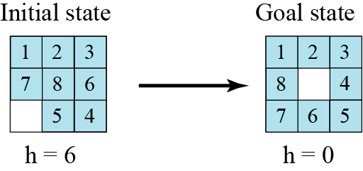
Heuristic search
Using heuristic search, we assign a quantitative value called a heuristic value (h value) to each node. This quantitative value shows the relative closeness of the node to the goal state. For example, consider solving the 8-puzzle.

Slide 86
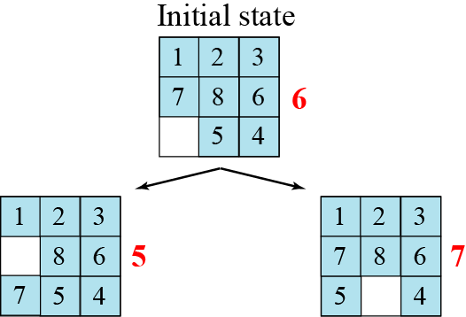

Slide 87
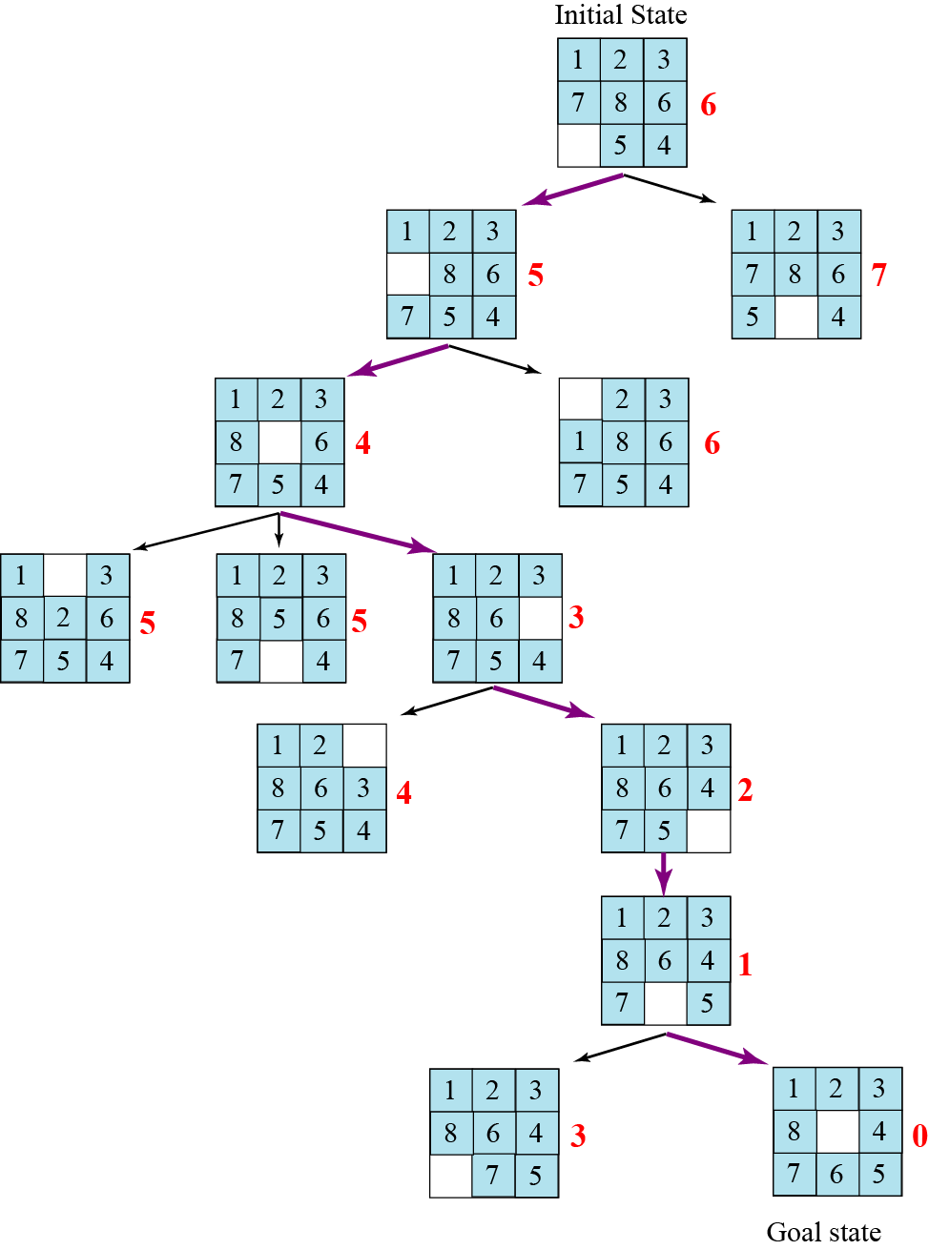

Slide 88
Uniform Cost Search
Uniform Cost Search
orders the nodes on the Q according to path cost from S
always expands the node with minimum path cost from S
Initialize: Let Q = {S}
While Q is not empty
pull Q1, the first element in Q
if Q1 is a goal report(success) and quit
else
child_nodes = expand(Q1)
<eliminate child_nodes which represent loops>
put remaining child_nodes in Q
sort Q according to path-cost to each node
end
Continue

Slide 89
Heuristics and Search
in general
a heuristic is a “rule-of-thumb” based on domain-dependent knowledge to help you solve a problem
in search
one uses a heuristic function of a state where h(node) = estimated cost of cheapest path from the state for that node to a goal state G
h(G) = 0
h(other nodes) ≥ 0
(note: we will assume all individual node-to-node costs are > 0)

Slide 90
A(*) Algorithm
Goal: Find shortest path
Prerequisites
Graph
Method to estimate distance between points (heuristic)
Basic Method
Try all paths?
Takes time
Orient search towards target
Minimizes areas of the map to be examined
Uses heuristics that indicate the estimated cost of getting to the destination
Main advantage

Slide 91
A(*) Algorithm
Algorithm
Open list
Nodes that need to be considered as possible starts for further extensions of the path
Closed list
Nodes that have had all their neighbors added to the open list
G score
Contains the length or weight of the path from the current node to the start node
Low lengths are better
Every node has a G score
H score
Heuristic
Resembles G score except it represents an estimate of the distance from the current node to the endpoint
To find shortest path, this score must underestimate the distance

Slide 92
The A* Algorithm
A heuristic h is admissible if
it for any node n it does NOT overestimate the true path cost from n to the nearest goal.
The A* search is a search algorithm orders the nodes on the Q according to f(n)=g(n)+h(n), where h(n) is an admissible heuristic
i.e., it sorts nodes on Q according to an admissible heuristic h*
It is like uniform-cost,
but uses fcost(node) = path-cost(S to node) + h(node)
rather than just path cost(S to node)
note that uniform cost search can be viewed as A* search where h(n) equals 0 for all n (the latter heuristic equal to 0 for every node is clearly admissible! Why?)

Slide 93
Pseudo-code for the A* Search Algorithm
Initialize: Let Q = {S}
While Q is not empty
pull Q1, the first element in Q
if Q1 is a goal report(success) and quit
else
child_nodes = expand(Q1)
<eliminate child_nodes which represent loops>
put remaining child_nodes in Q
sort Q according to ucost = pathcost(S to node) + h*(node)
end
Continue

Slide 94
Example of A* Algorithm in action
S
5 + 8.9 = 13.9
2 +10.4 = 12..4
A
D
3 + 6.7 = 9.7
B
D
4 + 8.9 = 12.9
7 + 4 = 11
8 + 6.9 = 14.9
C
E
E
6 + 6.9 = 12.9
Dead End
B
F
10 + 3.0 = 13
11 + 6.7 = 17.7
G
13 + 0 = 13

Slide 95
Comments on heuristic estimation
The estimate of the distance is called a heuristic
typically it comes from domain knowledge
e.g., the straight-line distance between 2 points
If the heuristic never overestimates, then the search procedure using this heuristic is “admissible”, i.e.,
h*(N) is less than or equal to realcost(N to G)
A* is a search with admissible heuristic is optimal
i.e., if one uses an admissible heuristic to order the search one is guaranteed to find the optimal solution
The closer the heuristic is to the real (unknown) path cost, the more effective it will be, ie if h1(n) and h2(n) are two admissible heuristics and h1(n)≤h2(n) for any node n then A* search with h2(n) will in general expand fewer nodes than A* search with h1(n)

Slide 96
Properties of A*
A* generates an optimal solution if h(n) is an admissible heuristic and the search space is a tree:
h(n) is admissible if it never overestimates the cost to reach the destination node
A* generates an optimal solution if h(n) is a consistent heuristic and the search space is a graph:
h(n) is consistent if for every node n and for every successor node n’ of n:
h(n) ≤ c(n,n’) + h(n’)
If h(n) is consistent then h(n) is admissible
Frequently when h(n) is admissible, it is also consistent

Slide 97
Admissible Heuristics
A heuristic is admissible if it is too optimistic, estimating the cost to be smaller than it actually is.
Example:
In the road map domain,
h(n) = “Euclidean distance to destination”
is admissible as normally cities are not connected by roads that make straight lines

Slide 98
Metric Space
A set of points X
Distance function d(x,y) d : X →[0… ∞)
d(x,y) = 0 iff x=y
d(x,y) = d(y,x) Symmetric
d(x,z) ≤ d(x,y) + d(y,z) Triangle inequality
Metric space M(X,d)
x
z
y

Slide 99
Dominance
If h2(n) ≥ h1(n) for all n (both admissible)
then h2 dominates h1
h2 is better for search: it is guaranteed to expand
less or equal nr of nodes.

Slide 100
Examples of Heuristic Functions for A*
the 8-puzzle problem
the number of tiles in the wrong position
is this admissible?
the sum of distances of the tiles from their goal positions, where distance is counted as the sum of vertical and horizontal tile displacements (“Manhattan distance”)
is this admissible?
How can we invent admissible heuristics in general?
look at “relaxed” problem where constraints are removed
e.g., we can move in straight lines between cities
e.g., we can move tiles independently of each other

Slide 101
IDA(*) Algorithm
A*, like depth-first search, except based on increasing values of total cost rather than increasing depths
IDA* sets bounds on the heuristic cost of a path, instead of depth
A* always finds a cheapest solution if the heuristic is admissible
IDA* is optimal in terms of solution cost, time, and space for admissible best-first searches on a tree

Slide 102
Pathfinding
First game to use a enemy tracking creditable AI was Pac-Man
“It was tricky because the monster movements are quite complex - one simply chases the player, two try to attack Pac-Man from the front, while the fourth will chase and then abruptly change course. This is the heart of the game”
- Toru Iwatani
The AI and it’s architecture - http://ai.berkeley.edu/project_overview.html
Notes:
The website shows a framework/architecture for students to use to implement their own AI
The framework is impressive in the sense it let’s users experiment their own AI on the framework provided

Slide 103
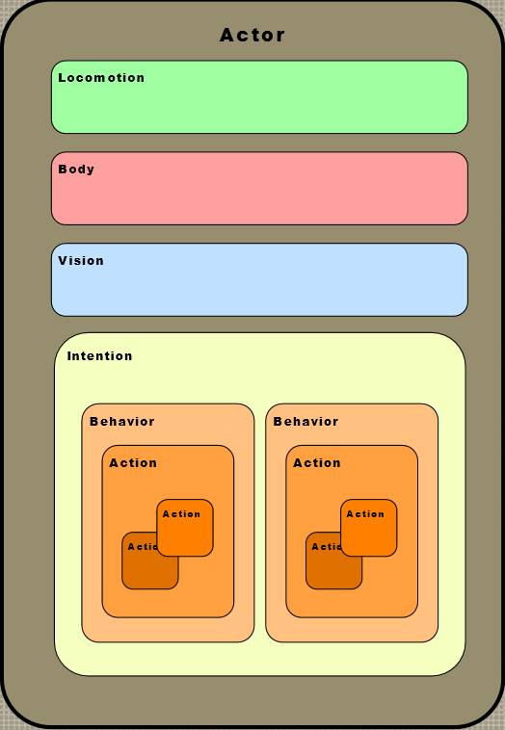
Path Finding
Valve Publications - http://www.valvesoftware.com/company/publications.html
Left 4 Dead - http://www.valvesoftware.com/publications/2009/ai_systems_of_l4d_mike_booth.pdf
Movement – Reactive Path Following – An optimized version of A*
Climbing – A modified version of Reactive Path following
Actor AI
Notes:
For Reactive path following – show the Left4Dead pdf
For the AI, show the next section

Slide 104
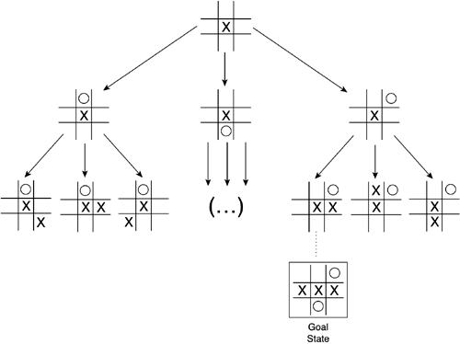
State Space
Model of a system as a set of input, output and state variables

Slide 105
Setting Up a State Space Model
State-space Model is a Model for The Search Problem
usually a set of discrete states X
e.g., in driving, the states in the model could be towns/cities
Start State - a state from X where the search starts
Goal State(s)
a goal is defined as a target state
For now: all goal states have utility 1, and all non-goals have utility 0
there may be many states which satisfy the goal
e.g., drive to a town with an airport
or just one state which satisfies the goal
e.g., drive to Las Vegas
Operators
operators are mappings from X to X
e.g. moves from one city to another that are legal (connected with a road)

Slide 106
A State Space and a Search Tree are different
S
B
D
S
B
C
C
B
State Space
Example of a Search Tree
A State Space represents all states and operators for the problem
A Search Tree is what an algorithm constructs as it solves a search problem:
so we can have different search trees for the same problem
search trees grow in a dynamic fashion until the goal is found

Slide 107
Puzzle-Solving as Search
You have a 3-gallon and a 4-gallon
You have a faucet with an unlimited amount of water
You need to get exactly 2 gallons in 4-gallon jug
State representation: (x, y)
x: Contents of four gallon
y: Contents of three gallon
Start state: (0, 0)
Goal state(s) G = {(2, 0), (2, 1), (2, 2)}
Operators
Fill 3-gallon (0,0)->(0,3), fill 4-gallon (0,0)->(0,4)
Fill 3-gallon from 4-gallon (4,0)->(1,3), fill 4-gallon from 3-gallon (0,3)->(3,0) or (1,3)->(4,0) or (2,3)->(4,0)….
Empty 3-gallon into 4-gallon, empty 4-gallon into 3-gallon
Dump 3-gallon down drain (0,3)->(0,0), dump 4-gallon down drain (4,0)->(0,0)

Slide 108
Evaluation function
Evaluation function or static evaluator is used to evaluate the “goodness” of a game position
Contrast with heuristic search where evaluation function was a non-negative estimate of the cost from the start node to a goal and passing through the given node
Zero-sum assumption lets us use a single evaluation function to describe goodness of a board wrt both players
f(n) >> 0: position n good for me and bad for you
f(n) << 0: position n bad for me and good for you
f(n) near 0: position n is a neutral position
f(n) = +infinity: win for me
f(n) = -infinity: win for you

Slide 109
Game Tree for Tic-Tac-Toe
MAX nodes
MAX’s play →
MIN nodes
MIN’s play →
Terminal state (win for MAX) →

Slide 110
Minimax procedure
Create start node as a MAX node with current board configuration
Expand nodes down to some depth (a.k.a. ply) of lookahead in the game
Apply the evaluation function at each of the leaf nodes
“Back up” values for each of the non-leaf nodes until a value is computed for the root node
At MIN nodes, the backed-up value is the minimum of the values associated with its children.
At MAX nodes, the backed-up value is the maximum of the values associated with its children.
Pick the operator associated with the child node whose backed-up value determined the value at the root

Slide 111
Minimax theorem
Intuition: assume your opponent is at least as smart as you are and play accordingly. If he’s not, you can only do better.
Von Neumann, J: Zur Theorie der Gesellschafts-spiele Math. Annalen. 100 (1928) 295-320
For every two-person, zero-sum game with finite strategies, there exists a value V and a mixed strategy for each player, such that (a) given player 2's strategy, the best payoff possible for player 1 is V, and (b) given player 1's strategy, the best payoff possible for player 2 is –V.
You can think of this as:
Minimizing your maximum possible loss
Maximizing your minimum possible gain

Slide 112
Alpha-beta pruning
We can improve on the performance of the minimax algorithm through alpha-beta pruning
Basic idea: “If you have an idea that is surely bad, don't take the time to see how truly awful it is.” -- Pat Winston
MAX
>=2
We don’t need to compute the value at this node.
No matter what it is, it can’t affect the value of the root node.
MIN
=2
<=1
MAX
2
7
1
?

Slide 113
Alpha-beta pruning
Traverse the search tree in depth-first order
At each MAX node n, alpha(n) = maximum value found so far
At each MIN node n, beta(n) = minimum value found so far
The alpha values start at -∞ and only increase, while beta values start at +∞ and only decrease
Beta cutoff: Given MAX node n, cut off search below n (i.e., don’t generate/examine any more of n’s children) if alpha(n) >= beta(i) for some MIN node ancestor i of n.
Alpha cutoff: stop searching below MIN node n if beta(n) <= alpha(i) for some MAX node ancestor i of n.

Slide 114
Alpha-beta algorithm
function MAX-VALUE (state, α, β)
;; α = best MAX so far; β = best MIN
if TERMINAL-TEST (state) then return UTILITY(state)
v := -∞
for each s in SUCCESSORS (state) do
v := MAX (v, MIN-VALUE (s, α, β))
if v >= β then return v
α := MAX (α, v)
end
return v
function MIN-VALUE (state, α, β)
if TERMINAL-TEST (state) then return UTILITY(state)
v := ∞
for each s in SUCCESSORS (state) do
v := MIN (v, MAX-VALUE (s, α, β))
if v <= α then return v
β := MIN (β, v)
end
return v

Slide 115
Algorithms for search
BFS, DFS, Dijkstra, MSTs (Prim & Kruskal), Bellman-Ford
Data Structures for search

Slide 116
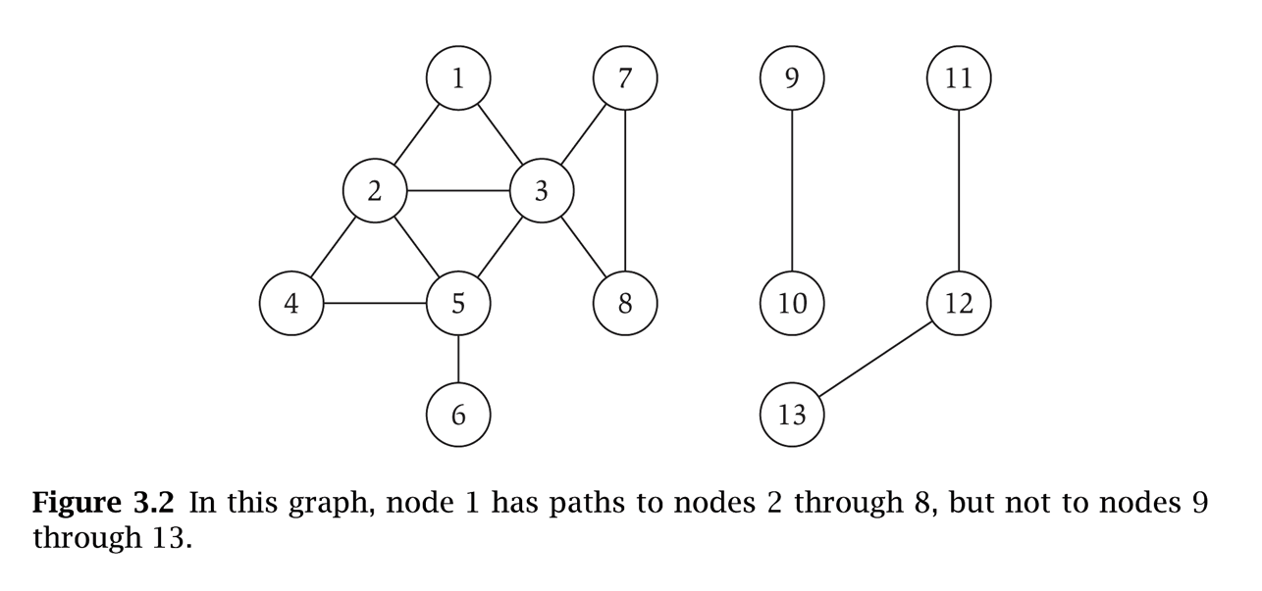
Graph Representation: Adjacency Matrix
Adjacency matrix. n-by-n matrix with A_{uv} = 1 if (u, v) is an edge.
Two representations of each edge.
Space proportional to n².
Checking if (u, v) is an edge takes Θ(1) time.
Identifying all edges takes Θ(n²) time.
1 2 3 4 5 6 7 8
1 0 1 1 0 0 0 0 0
2 1 0 1 1 1 0 0 0
3 1 1 0 0 1 0 1 1
4 0 1 0 1 1 0 0 0
5 0 1 1 1 0 1 0 0
6 0 0 0 0 1 0 0 0
7 0 0 1 0 0 0 0 1
8 0 0 1 0 0 0 1 0

Slide 117
Graph Representation: Adjacency List
Adjacency list. Node indexed array of lists.
Two representations of each edge.
Space proportional to m + n.
Checking if (u, v) is an edge takes O(deg(u)) time.
Identifying all edges takes Θ(m + n) time.
degree = number of neighbors of u
1
2
3
2
1
3
4
5
3
1
2
5
7
8
4
2
5
5
2
3
4
6
6
5
7
3
8
8
3
7

Slide 118
Paths and Connectivity
Def. A path in an undirected graph G = (V, E) is a sequence P of nodes v₁, v₂, …, v_{k-1}, v_{k} with the property that each consecutive pair v_{i}, v_{i+1} is joined by an edge in E.
Def. A path is simple if all nodes are distinct.
Def. An undirected graph is connected if for every pair of nodes u and v, there is a path between u and v.

Slide 119
Cycles
Def. A cycle is a path v₁, v₂, …, v_{k-1}, v_{k} in which v₁ = v_{k}, k > 2, and the first k-1 nodes are all distinct.
cycle C = 1-2-4-5-3-1

Slide 120
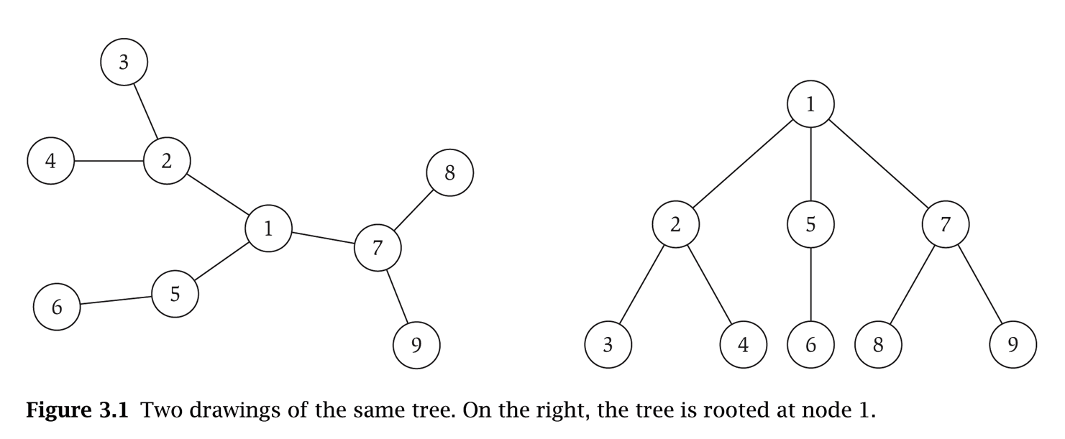
Trees
Def. An undirected graph is a tree if it is connected and does not contain a cycle.
Theorem. Let G be an undirected graph on n nodes. Any two of the following statements imply the third.
G is connected.
G does not contain a cycle.
G has n-1 edges.

Slide 121
Rooted Trees
Rooted tree. Given a tree T, choose a root node r and orient each edge away from r.
root r
parent of v
v
child of v
a tree
the same tree, rooted at 1
Notes:
by rooting a tree, it's easy to see that it has n-1 edges (exactly one edge leading upward from each non-root node.)

Slide 122
Bipartite Graphs
Def. An undirected graph G = (V, E) is bipartite if the nodes can be colored red or blue such that every edge has one red and one blue end.
a bipartite graph

Slide 123
An Obstruction to Bipartiteness
Lemma. If a graph G is bipartite, it cannot contain an odd length cycle.
bipartite (2-colorable)
not bipartite (not 2-colorable)

Slide 124
Dijkstra's Shortest Path Algorithm
Find shortest path from s to t.
2
24
3
9
s
18
14
6
6
2
30
4
19
11
15
5
5
6
20
16
7
t
44

Slide 125
Dijkstra's Shortest Path Algorithm
S = { }
PQ = { s, 2, 3, 4, 5, 6, 7, t }
∞
∞
2
24
3
0
9
s
∞
18
14
6
6
2
∞
30
∞
4
19
11
15
5
5
6
20
16
7
t
44
distance label
∞
∞

Slide 126
Dijkstra's Shortest Path Algorithm
S = { }
PQ = { s, 2, 3, 4, 5, 6, 7, t }
delmin
∞
∞
2
24
3
0
9
s
∞
18
14
6
6
2
∞
30
∞
4
19
11
15
5
5
6
20
16
7
t
44
distance label
∞
∞

Slide 127
Dijkstra's Shortest Path Algorithm
S = { s }
PQ = { 2, 3, 4, 5, 6, 7, t }
decrease key
∞
∞
9
X
2
24
3
0
9
s
∞
14
18
14
X
6
6
2
∞
30
∞
4
19
11
15
5
5
6
20
16
7
t
44
distance label
∞
15
∞
X

Slide 128
Dijkstra's Shortest Path Algorithm
S = { s }
PQ = { 2, 3, 4, 5, 6, 7, t }
delmin
∞
∞
9
X
2
24
3
0
9
s
∞
14
18
14
X
6
6
2
∞
30
∞
4
19
11
15
5
5
6
20
16
7
t
44
distance label
∞
15
∞
X

Slide 129
Dijkstra's Shortest Path Algorithm
S = { s, 2 }
PQ = { 3, 4, 5, 6, 7, t }
∞
∞
9
X
2
24
3
0
9
s
∞
14
18
14
X
6
6
2
∞
30
∞
4
19
11
15
5
5
6
20
16
7
t
44
∞
15
∞
X

Slide 130
Dijkstra's Shortest Path Algorithm
S = { s, 2 }
PQ = { 3, 4, 5, 6, 7, t }
decrease key
∞
33
∞
X
9
X
2
24
3
0
9
s
∞
14
18
14
X
6
6
2
∞
30
∞
4
19
11
15
5
5
6
20
16
7
t
44
∞
15
∞
X

Slide 131
Dijkstra's Shortest Path Algorithm
S = { s, 2 }
PQ = { 3, 4, 5, 6, 7, t }
∞
33
∞
X
9
X
2
24
3
0
9
delmin
s
∞
14
18
14
X
6
6
2
∞
30
∞
4
19
11
15
5
5
6
20
16
7
t
44
∞
15
∞
X

Slide 132
Dijkstra's Shortest Path Algorithm
S = { s, 2, 6 }
PQ = { 3, 4, 5, 7, t }
32
∞
33
∞
X
X
9
X
2
24
3
0
9
s
∞
14
18
14
X
6
6
2
44
∞
∞
4
30
X
19
11
15
5
5
6
20
16
7
t
44
∞
15
∞
X

Slide 133
Dijkstra's Shortest Path Algorithm
S = { s, 2, 6 }
PQ = { 3, 4, 5, 7, t }
32
∞
33
∞
X
X
9
X
2
24
3
0
9
s
∞
14
18
14
X
6
6
2
44
∞
∞
4
30
X
19
11
15
5
5
6
20
16
7
t
44
∞
15
delmin
∞
X

Slide 134
Dijkstra's Shortest Path Algorithm
S = { s, 2, 6, 7 }
PQ = { 3, 4, 5, t }
32
∞
33
∞
X
X
9
X
2
24
3
0
9
s
∞
14
18
14
X
6
6
2
44
35
∞
X
∞
4
30
X
19
11
15
5
5
6
20
16
7
t
44
59
∞
∞
15
X
X

Slide 135
Dijkstra's Shortest Path Algorithm
S = { s, 2, 6, 7 }
PQ = { 3, 4, 5, t }
delmin
32
∞
33
∞
X
X
9
X
2
24
3
0
9
s
∞
14
18
14
X
6
6
2
44
35
∞
X
∞
4
30
X
19
11
15
5
5
6
20
16
7
t
44
59
∞
∞
15
X
X

Slide 136
Dijkstra's Shortest Path Algorithm
S = { s, 2, 3, 6, 7 }
PQ = { 4, 5, t }
32
∞
33
∞
X
X
9
X
2
24
3
0
9
s
∞
14
18
14
X
6
6
2
44
35
34
∞
X
X
∞
4
30
X
19
11
15
5
5
6
20
16
7
t
44
51
59
∞
∞
15
X
X
X

Slide 137
Dijkstra's Shortest Path Algorithm
S = { s, 2, 3, 6, 7 }
PQ = { 4, 5, t }
32
∞
33
∞
X
X
9
X
2
24
3
0
9
s
∞
14
18
14
X
6
6
2
44
35
34
∞
X
X
∞
4
30
X
19
11
15
5
5
6
20
delmin
16
7
t
44
51
59
∞
∞
15
X
X
X

Slide 138
Dijkstra's Shortest Path Algorithm
S = { s, 2, 3, 5, 6, 7 }
PQ = { 4, t }
32
∞
33
∞
X
X
9
X
2
24
3
0
9
s
∞
14
18
14
X
6
6
2
35
34
45
∞
44
X
X
X
∞
4
30
X
19
11
15
5
5
6
20
16
7
t
44
50
51
59
∞
∞
15
X
X
X
X

Slide 139
Dijkstra's Shortest Path Algorithm
S = { s, 2, 3, 5, 6, 7 }
PQ = { 4, t }
32
∞
33
∞
X
X
9
X
2
24
3
0
9
s
∞
14
18
14
X
6
6
2
35
34
45
∞
44
X
X
X
∞
4
30
X
19
11
15
5
delmin
5
6
20
16
7
t
44
50
51
59
∞
∞
15
X
X
X
X

Slide 140
Dijkstra's Shortest Path Algorithm
S = { s, 2, 3, 4, 5, 6, 7 }
PQ = { t }
32
∞
33
∞
X
X
9
X
2
24
3
0
9
s
∞
14
18
14
X
6
6
2
35
34
45
∞
44
X
X
X
∞
4
30
X
19
11
15
5
5
6
20
16
7
t
44
50
51
59
∞
∞
15
X
X
X
X

Slide 141
Dijkstra's Shortest Path Algorithm
S = { s, 2, 3, 4, 5, 6, 7 }
PQ = { t }
32
∞
33
∞
X
X
9
X
2
24
3
0
9
s
∞
14
18
14
X
6
6
2
35
34
45
∞
44
X
X
X
∞
4
30
X
19
11
15
5
5
6
20
16
7
t
44
delmin
50
51
59
∞
∞
15
X
X
X
X

Slide 142
Dijkstra's Shortest Path Algorithm
S = { s, 2, 3, 4, 5, 6, 7, t }
PQ = { }
32
∞
33
∞
X
X
9
X
2
24
3
0
9
s
∞
14
18
14
X
6
6
2
35
34
45
∞
44
X
X
X
∞
4
30
X
19
11
15
5
5
6
20
16
7
t
44
50
51
59
∞
∞
15
X
X
X
X

Slide 143
Dijkstra's Shortest Path Algorithm
S = { s, 2, 3, 4, 5, 6, 7, t }
PQ = { }
32
∞
33
∞
X
X
9
X
2
24
3
0
9
s
∞
14
18
14
X
6
6
2
35
34
45
∞
44
X
X
X
∞
4
30
X
19
11
15
5
5
6
20
16
7
t
44
50
51
59
∞
∞
15
X
X
X
X

Slide 144
Minimum Spanning Tree
Minimum spanning tree. Given a connected graph G = (V, E) with real-valued edge weights c_{e}, an MST is a subset of the edges T ⊆ E such that T is a spanning tree whose sum of edge weights is minimized.
Cayley's Theorem. There are n^{n-2} spanning trees of K_{n}.
4
24
4
6
23
9
9
18
6
5
11
5
11
16
8
8
14
7
7
10
21
G = (V, E)
T, Σ_{e∈T} c_{e} = 50
can't solve by brute force
Notes:
Cayley (1821-1895) was one of great mathematicians of 19th century, but his 1889 paper did not contain a rigorous proof of Cayley's Theorem.

Slide 145
Greedy Algorithms
Simplifying assumption. All edge costs c_{e} are distinct.
Cut property. Let S be any subset of nodes, and let e be the min cost edge with exactly one endpoint in S. Then the MST contains e.
Cycle property. Let C be any cycle, and let f be the max cost edge belonging to C. Then the MST does not contain f.
C
f
S
e
e is in the MST
f is not in the MST
Notes:
Note: simplifying assumption guarantees that MST in unique so it make sense to refer to "the MST"

Slide 146
Cycle-Cut Intersection
Claim. A cycle and a cutset intersect in an even number of edges.
2
3
1
Cycle C = 1-2, 2-3, 3-4, 4-5, 5-6, 6-1 Cutset D = 3-4, 3-5, 5-6, 5-7, 7-8 Intersection = 3-4, 5-6
6
4
5
7
8
C
S
V - S

Slide 147
Prim's Algorithm
Prim's algorithm. [Jarník 1930, Dijkstra 1957, Prim 1959]
Initialize S = any node.
Apply cut property to S.
Add min cost edge in cutset corresponding to S to T, and add one new explored node u to S.
S

Slide 148
Kruskal's Algorithm
Kruskal's algorithm. [Kruskal, 1956]
Consider edges in ascending order of weight.
Case 1: If adding e to T creates a cycle, discard e according to cycle property.
Case 2: Otherwise, insert e = (u, v) into T according to cut property where S = set of nodes in u's connected component.
v
e
S
e
u
Case 1
Case 2

Slide 149
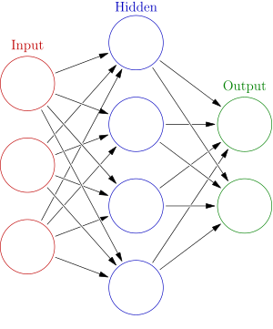
Neural Networks
The human brain can be described as a biological neural network—an interconnected web of neurons transmitting elaborate patterns of electrical signals. Dendrites receive input signals and, based on those inputs, fire an output signal via an axon.

Slide 150
Artificial neural network
Artificial neural networks (ANNs) are a family of models inspired by biological neural networks
There is no single formal definition of what an artificial neural network is. However, a class of statistical models may commonly be called "neural" if it possesses the following characteristics:
contains sets of adaptive weights, i.e. numerical parameters that are tuned by a learning algorithm, and
capability of approximating non-linear functions of their inputs.

Slide 151
Artificial Neural Networks
Supervised Learning – Othello: http://www.sciencedirect.com/science/article/pii/S187704281204668X
Alpha Beta Search Algorithm
NN to perfect the board value at each leaf node, improving the search algorithm
After 800 generations, the AI would predict the next move in more than 97% of the games played.
Backgammin - http://www.cs.cornell.edu/boom/2001sp/Tsinteris/gammon.htm
Unreal Tournment
Bot trained using Supervised and Unsupervised learning
After 8000 training sets, the bot generated it’s rule set
Creatures
Players interact with Norms by ‘guiding’ it via a reward-punish system
Uses in Games
Control – Learn and control an actor
Threat Assessment – Used in RTS games to assess opponents based on previous experiences
Anticipation – One-on-one games like MK to model player behavior
Notes:
Show the Racing Game video
Show the Jumping video
Show the fighting video
Talk about Fuzzy logic (if you have time)

Slide 152

Graphics Project (NN Plays Flappy Bird)
NEU student created a system where a Neural Network processes a 5 minute recording of me playing Flappy Bird and uses that to learn, in a supervised fashion, how to play better than I did. It was able to take my max score of 20 and get a score of 165.
Video: https://www.youtube.com/watch?v=nSX2diHPQMg

Slide 153
Neural Network History
History traces back to the 50’s but became popular in the 80’s with work by Rumelhart, Hinton, and Mclelland
A General Framework for Parallel Distributed Processing in Parallel Distributed Processing: Explorations in the Microstructure of Cognition
Peaked in the 90’s. Today:
Hundreds of variants
Less a model of the actual brain than a useful tool, but still some debate
Numerous applications
Handwriting, face, speech recognition
Vehicles that drive themselves
Models of reading, sentence production, dreaming
Debate for philosophers and cognitive scientists
Can human consciousness or cognitive abilities be explained by a connectionist model or does it require the manipulation of symbols?

Slide 154
Artificial neural networks
Output
Inputs
An artificial neural network is composed of many artificial neurons that are linked together according to a specific network architecture. The objective of the neural network is to transform the inputs into meaningful outputs.

Slide 155
Perceptrons
Initial proposal of connectionist networks
Rosenblatt, 50’s and 60’s
Essentially a linear discriminant composed of nodes, weights
I1
W1
I1
W1
or
W2
W2
O
I2
O
I2
W3
W3
I3
Activation Function
I3
1

Slide 156
Perceptron Example
2
.5
.3
=-1
1
2(0.5) + 1(0.3) + -1 = 0.3 , O=1
Learning Procedure:
Randomly assign weights (between 0-1)
Present inputs from training data
Get output O, nudge weights to gives results toward our desired output T
Repeat; stop when no errors, or enough epochs completed

Slide 157
Backpropagation Networks
Attributed to Rumelhart and McClelland, late 70’s
To bypass the linear classification problem, we can construct multilayer networks. Typically we have fully connected, feedforward networks.
Input Layer
Hidden Layer
Output Layer
I1
O1
H1
I2
H2
O2
I3
W_{i,j}
1
W_{j,k}
1
1’s - bias

Slide 158
Backpropagation Networks
Very powerful - can learn any function, given enough hidden units! With enough hidden units, we can generate any function.
Have the same problems of Generalization vs. Memorization. With too many units, we will tend to memorize the input and not generalize well. Some schemes exist to “prune” the neural network.
Networks require extensive training, many parameters to fiddle with. Can be extremely slow to train. May also fall into local minima.
Inherently parallel algorithm, ideal for multiprocessor hardware.
Despite the cons, a very powerful algorithm that has seen widespread successful deployment.

Slide 159
Unsupervised Learning – Hopfield Networks
A Hopfield network is a type of content-addressable memory
Non-linear system with attractor points that represent concepts
Given a fuzzy input the system converges to the nearest attractor
Possibility to have “spurious” attractors that is a blend of multiple stored patterns
Also possible to have chaotic patterns that never converge

Slide 160
Hopfield Neural Networks
Hopfield networks. Simple model of an associative memory, in which a large collection of units are connected by an underlying network, and neighboring units try to correlate their states.
Input: Graph G = (V, E) with integer edge weights w.
Configuration. Node assignment s_{u} = ± 1.
Intuition. If w_{uv} < 0, then u and v want to have the same state; if w_{uv} > 0 then u and v want different states.
positive or negative
7
5
6

Slide 161
Hopfield Neural Networks
Def. With respect to a configuration S, edge e = (u, v) is good if w_{e} s_{u} s_{v} < 0. That is, if w_{e} < 0 then s_{u} = s_{v}; if w_{e} > 0, s_{u} ≠ s_{v}.
Def. With respect to a configuration S, a node u is satisfied if the weight of incident good edges ≥ weight of incident bad edges.
Def. A configuration is stable if all nodes are satisfied.
Goal. Find a stable configuration, if such a configuration exists.
4
-1
-10
satisfied node: 5 - 4 - 1 - 1 < 0
-5
-1
bad edge

Slide 162
Hopfield Neural Networks
Goal. Find a stable configuration, if such a configuration exists.
State-flipping algorithm. Repeated flip state of an unsatisfied node.
Hopfield-Flip(G, w) {
S ← arbitrary configuration
while (current configuration is not stable) {
u ← unsatisfied node
s_{u} = -s_{u}
}
return S
}

Slide 163
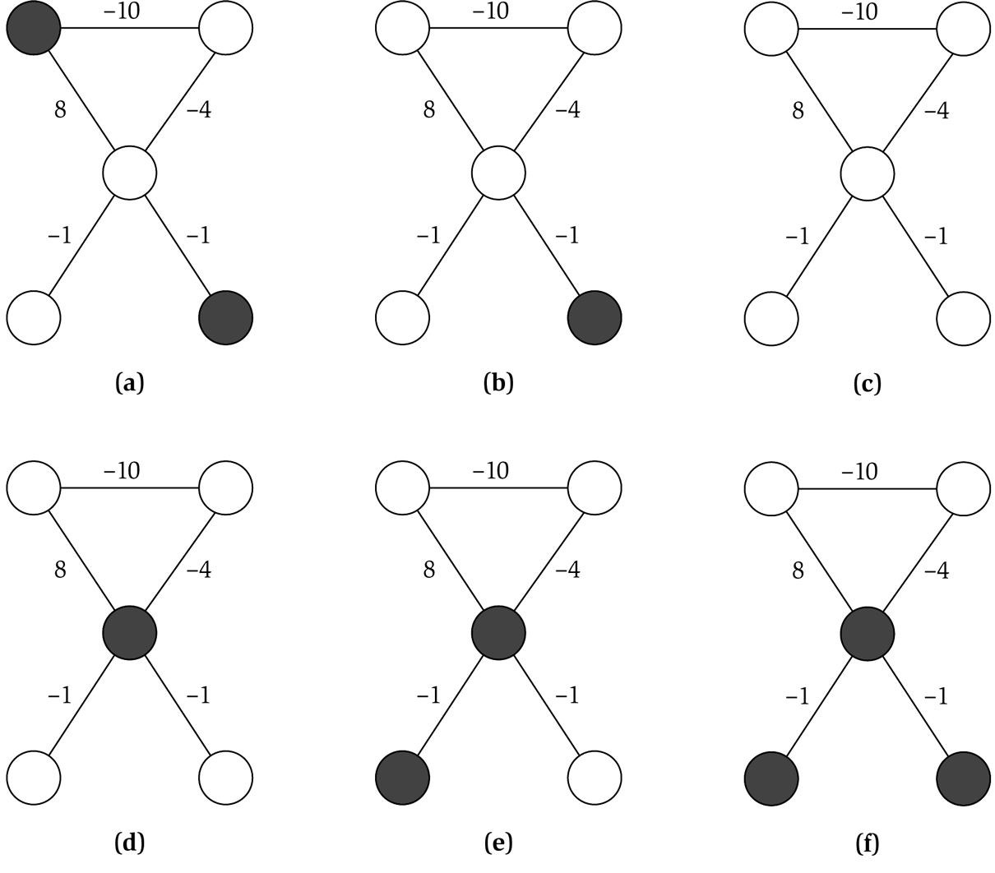
State Flipping Algorithm
unsatisfied node 10 - 8 > 0
unsatisfied node 8 - 4 - 1 - 1 > 0
stable

Slide 164
Hopfield Memories
Setting the weights:
A pattern is a setting of on or off for each unit
Given a set of Q patterns to store
For every weight connecting units i and j:
This is a form of a Hebbian rule which makes the weight strength proportional to the product of the firing rates of the two interconnected units

Slide 165
Unsupervised Learning – Self Organizing Maps
Self-organizing maps (SOMs) are a data visualization technique invented by Professor Teuvo Kohonen
Also called Kohonen Networks, Competitive Learning, Winner-Take-All Learning
Generally reduces the dimensions of data through the use of self-organizing neural networks
Useful for data visualization; humans cannot visualize high dimensional data so this is often a useful technique to make sense of large data sets

Slide 166
Basic “Winner Take All” Network
Two layer network
Input units, output units, each input unit is connected to each output unit
Input Layer
Output Layer
I1
O1
I2
O2
I3
W_{i,j}

Slide 167
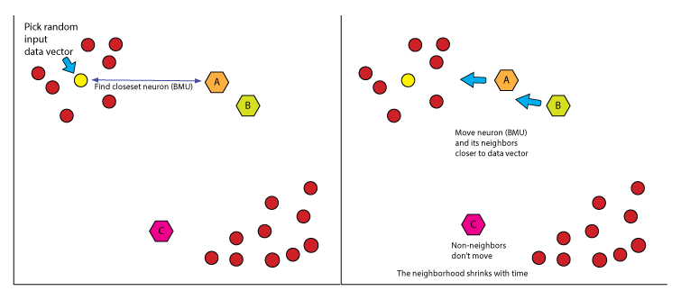
Self Organizing Maps
A self-organizing map (SOM) or self-organizing feature map (SOFM) is an artificial neural network (ANN) that is trained using unsupervised learning to produce a low-dimensional (typically two-dimensional), discretized representation of the input space of the training samples, called a map.

Slide 168
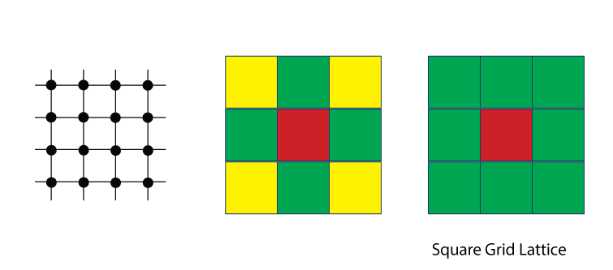
SOM neighborhood topology
Square Grid Lattice SOM

Slide 169
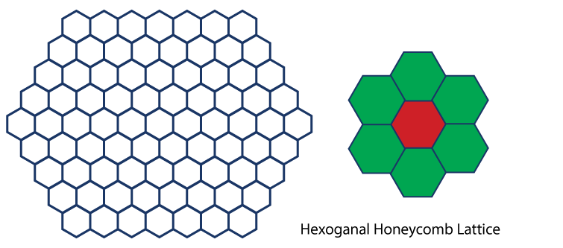
SOM neighborhood topology
Hexoganal Honeycomb Lattice SOM

Slide 170
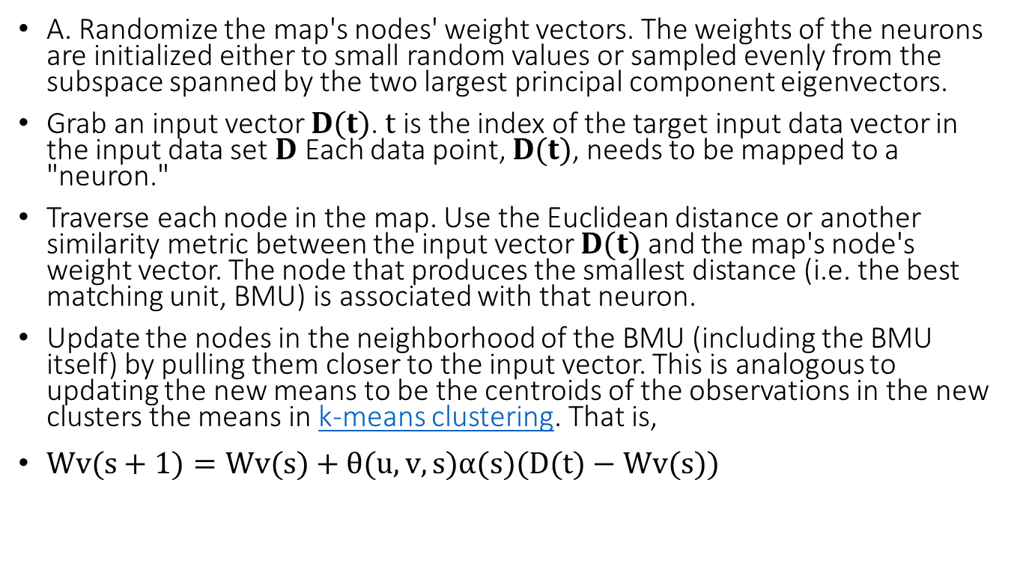
SOM Algorithm
A. Randomize the map's nodes' weight vectors. The weights of the neurons are initialized either to small random values or sampled evenly from the subspace spanned by the two largest principal component eigenvectors.
Grab an input vector $D(t)$. $t$ is the index of the target input data vector in the input data set $D$ Each data point, $D(t)$, needs to be mapped to a "neuron."
Traverse each node in the map. Use the Euclidean distance or another similarity metric between the input vector $D(t)$ and the map's node's weight vector. The node that produces the smallest distance (i.e. the best matching unit, BMU) is associated with that neuron.
Update the nodes in the neighborhood of the BMU (including the BMU itself) by pulling them closer to the input vector. This is analogous to updating the new means to be the centroids of the observations in the new clusters the means in k-means clustering. That is,
$Wv(s+1)=Wv(s)+θ(u,v,s)α(s)(D(t)−Wv(s))$

Slide 171
SOM Algorithm
Initialize Map (randomly assign weights)
Loop over training examples
Assign input unit values according to the values in the current example
Find the “winner”, i.e. the output unit that most closely matches the input units, using some distance metric, e.g.
Modify weights on the winner to more closely match the input
For all output units j=1 to m
and input units i=1 to n
Find the one that minimizes:
where c is a small positive learning constant
that usually decreases as the learning proceeds

Slide 172
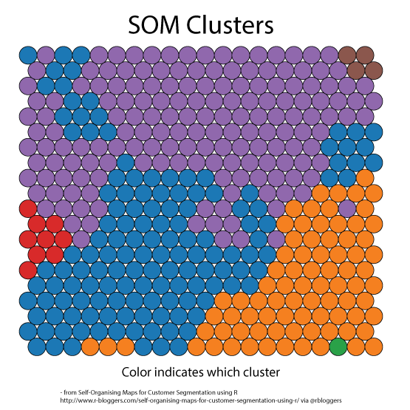
SOM Cluster Maps

Slide 173
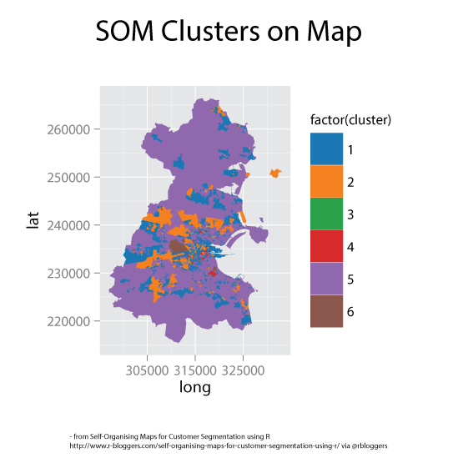
SOM Cluster Maps

Slide 174
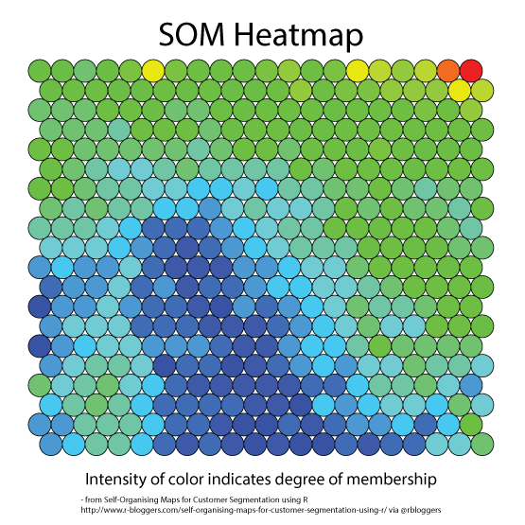
SOM Cluster Maps

Slide 175

Genetic Algorithms
A genetic algorithm (GA) is a method for solving both constrained and unconstrained optimization problems based on a natural selection process that mimics biological evolution. The algorithm repeatedly modifies a population of individual solutions.

Slide 176
Genetic Algorithms
Developed: USA in the 1970’s
Early names: J. Holland, K. DeJong, D. Goldberg
Typically applied to:
discrete optimization
Attributed features:
not too fast
good heuristic for combinatorial problems
Special Features:
Traditionally emphasizes combining information from good parents (crossover)
many variants, e.g., reproduction models, operators

Slide 177
Genetic algorithms
Holland’s original GA is now known as the simple genetic algorithm (SGA)
Other GAs use different:
Representations
Mutations
Crossovers
Selection mechanisms

Slide 178
Genetic algorithms
Representation | Binary strings
Recombination | N-point or uniform
Mutation | Bitwise bit-flipping with fixed probability
Parent selection | Fitness-Proportionate
Survivor selection | All children replace parents
Speciality | Emphasis on crossover

Slide 179
Genetic algorithms
Select parents for the mating pool
(size of mating pool = population size)
Shuffle the mating pool
For each consecutive pair apply crossover with probability p_{c} , otherwise copy parents
For each offspring apply mutation (bit-flip with probability p_{m} independently for each bit)
Replace the whole population with the resulting offspring

Slide 180
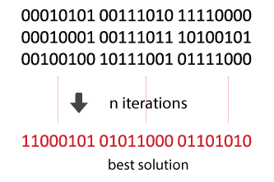
Genetic algorithms
A genetic algorithm (GA) is a search heuristic that mimics the process of natural selection. This heuristic is often used to generate useful solutions to optimization and search problems.

Slide 181
Genetic Algorithm Pseudocode
Create an initial population, typically random
While the best candidate so far is not a solution: Create new population using crossover and mutation. Evaluate the fitness of each candidate in the population. Replace/delete least-fit population
Return the best candidate found

Slide 182
Genetic Algorithm Basic components
Candidate representation
Important to choose this well the form can effect the solution.
The typical candidate representation is a binary string.
successor functions.
Mutation, crossover
Mutation - Given a candidate, return a slightly different candidate.
Crossover - Given two candidates, produce one that has elements of each.
Fitness function
The fitness function quantitates estimates how close a candidate is to being a solution.
Solution test
Check whether the candidate is a solution.
Some parameters
Population size
Generation limit

Slide 183
Genetic Algorithm - Pros and Cons
Pros * Fast (and low memory) * Finding a candidate representation and fitness function are the bulk of the work.
Cons * Randomized (not guaranteed optimal or complete). * Can get stuck on local maxima (crossover is intended to help get out of local maxima)

Slide 184
Emergent Behavior (flocking)
In philosophy, systems theory, science, and art, emergence is a process whereby larger entities, patterns, and regularities arise through interactions among smaller or simpler entities that themselves do not exhibit such properties.
Spectacular Starling Flock https://youtu.be/8vhE8ScWe7

Slide 185

What is a flock?
One definition: a group of birds or mammals assembled or herded together

Slide 186
Why model flocking?
It looks cool
Difficult to animate using traditional keyframing or other techniques
Hard to script the path
Hard to handle motion constraints
Hard to edit motion

Slide 187
Massive Software – Simulating Life
www.massivesoftware.com/
Simulation and visualization tools for autonomous agent driven animation for film, games, television, architecture and transportation.
Massive Software Demo Reel https://youtu.be/cr5Cwz-5Wsw

Slide 188
Artificial Life (A-Life)
Artificial life (often abbreviated ALife or A-Life^{[1]}) is a field of study and an associated art form which examine systems related to life, its processes, and its evolution, through the use of simulations with computer models, robotics, and biochemistry.
Gridworld - Evolving Artificial Life https://youtu.be/Ksf6nFsr29Q

Slide 189
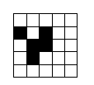
Cellular Automata
Cell
State = empty/off/0
State = filled/on/1
An automaton consists of a grid/lattice of cells each of which can be in a (normally small and finite) number of states
The figure shows a 5x5 automaton where each cell can be in a filled or empty state.

Slide 190
State Transition Rules
The states of an automaton change over time in discrete timesteps
The state of each cell is modified in parallel at each timestep according to the state transition rules
These determine the new states of each of the cells in the next timestep from the states of that cells neighbours
For (int i=0 to CellCount)
{
Cell[i].State[t+1] = STR(Cell[i].Neighbour.State[t]
}

Slide 191
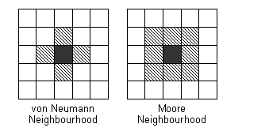
Neighbourhoods
Neighbourhood's are important as mechanisms for controlling the execution of the CA
Neighbourhoods determine the extent of the interaction between cells in the grid
Two popular neighbourhoods are:

Slide 192
Fractals
The term fractal was coined in 1975 by Benoît Mandelbrot, from the Latin fractus, meaning "broken" or "fractured".
(colloquial) a shape that is recursively constructed or self-similar, that is, a shape that appears similar at all scales of magnification.
(mathematics) a geometric object that has a Hausdorff dimension greater than its topological dimension.

Slide 193
Opponent Modeling
Game Theory based opponent modeling - https://www.cs.cmu.edu/~sganzfri/DBBR_AAMAS11.pdf
The math is based on Game Theory and Probabilistic analysis
Spring - https://dke.maastrichtuniversity.nl/frederik.schadd/wp-content/uploads/2013/04/Game-On-07-submission.pdf
Hierarchically structured classification
Used SPRING as the test bed – RTS game, win by capturing opponent’s base
Each action is an event
Events are then classified with a threshold
Notes:
For Game theiry, don’t take too long. Talk about how math is used to figure out player’s next move
For Spring, talk about the hierarchial structuring

Slide 194
Procedural Content Generation
A good start - http://pcgbook.com/
Places to use PCG - http://www.ds.ewi.tudelft.nl/~iosup/pcg-g-survey11tomccap_cr.pdf
Game Bits – foliage, buildings, sound, etc..
Game Space – maps, internal structures, etc..
Game Systems – actor evolution (Ultima Online), entity behavior (Watch Dogs 2)
Game Scenarios – Story of the game (Bethesda games), Story Levels (Super Mario Bros)
Derived Content – Customization (Dishonored)
Challeneges and future of PCG - http://drops.dagstuhl.de/opus/volltexte/2013/4336/pdf/7.pdf
Usually custom built
State of the art and uses of PCG techniques in the above mentioned areas
PCG used in Unreal Engine
Foliage generator
Notes:
Show the REZ video when talking about places to use PCG

Slide 195
L-Systems
An L-system or Lindenmayer system, after Aristid Lindenmayer (1925–1989), is a formal grammar (a set of rules and symbols) most famously used to model the growth processes of plant development, though able to model the morphology of a variety of organisms.
L-systems can also be used to generate self-similar fractals such as iterated function systems.

Slide 196
L-System Grammar
G = {V, S, ω, P}, where
V (the alphabet) is a set of variables
S is a set of constant symbols
ω (start, axiom or initiator) is a string of symbols from V defining the initial state of the system
P is a set of rules or productions defining the way variables can be replaced with combinations of constants and other variables.
A production consists of two strings - the predecessor and the successor.

Slide 197
L-System Examples
Koch curve (from wikipedia)
A variant which uses only right-angles.
variables : F
constants : + −
start : F
rules : (F → F+F−F−F+F)
Here, F means "draw forward", + means "turn left 90°", and - means "turn right 90°" (see turtle graphics).

Slide 198
L-System Data Files
Koch Triangle Form // title
4 // number of levels to iterate
90 // angle to turn
F // starting shape
F:F+F-F-F+F // a rule
F
F+F-F-F+F
F+F-F-F+F+F+F-F-F+F-F+F-F-F+F-F+F-F-F+F+F+F-F-F+F

Slide 199
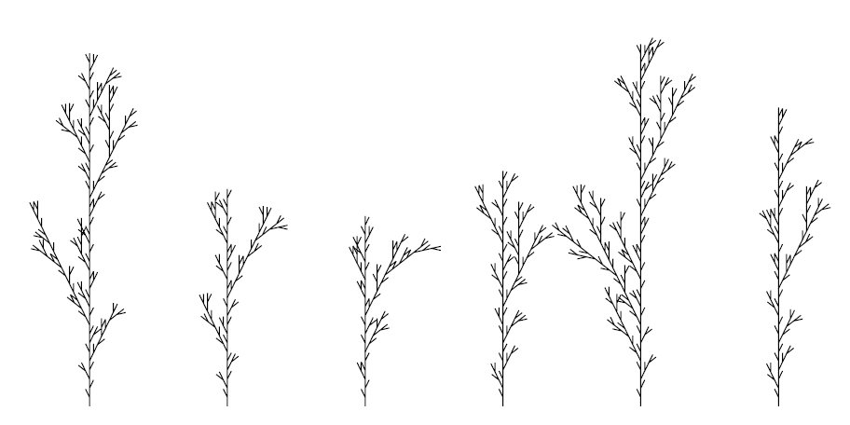
Stochastic L-Systems
seed: 2454 // different seeds for different trees
derivation length: 3
axiom: F
F--> F[+F]F[-F]F : 1/3
F--> F[+F]F : 1/3
F--> F[-F]F : 1/3

Slide 200
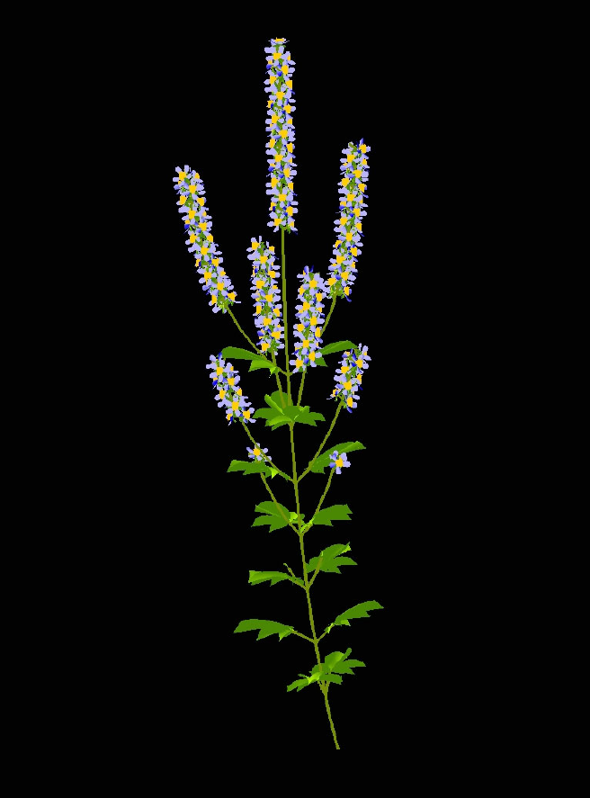
A Mint http://algorithmicbotany.org/papers/
A model of a member of the mint family that exhibits a basipetal
flowering sequence.

Slide 201
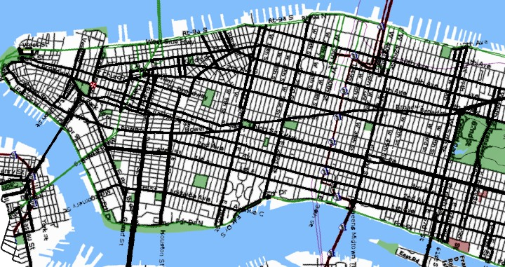
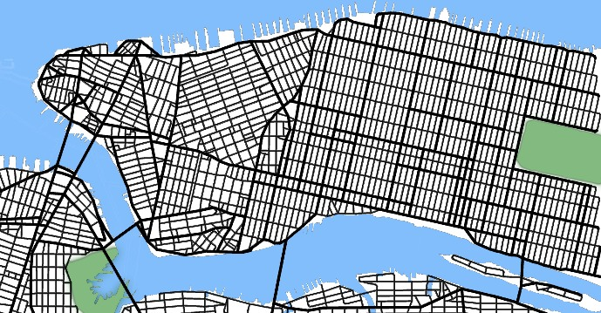
L-Systems for Cities
Start with a single street
Branch & extend w/ parametric L-System
Parameters of the string are tweaked by goals/constraints
Goals control street direction, spacing
Contraints allow for parks, bridges, road loops
Once we have streets, we can form buildings with another L-System
Building shapes are represented as CSG operations on simple shapes

Slide 202
Procedural Terrain: Perlin Noise
Noise Functions
Seeded pseudo-random number generator
Over R^{n}
Approximation to gaussian filtered noise
Implemented as a pseudo-random spline
The trick is to make it fast

Slide 203
Perlin Noise
Many people have used random number generators in their programs to create unpredictability, making the motion and behavior of objects appear more natural
But at times their output can be too harsh to appear natural.
The Perlin noise function recreates this by simply adding up noisy functions at a range of different scales.

Slide 204

Perlin Noise - The Oscar™
To Ken Perlin for the development of Perlin Noise, a technique used to produce natural appearing textures on computer generated surfaces for motion picture visual effects.

Slide 205
Perlin Noise - The Movies
James Cameron Movies (Abyss,Titanic,...)
Animated Movies (Lion King, Moses,...)
Arnold Movies (T2, True Lies, ...)
Star Wars Episode I
Star Trek Movies
Batman Movies
and lots of others
In fact, after around 1990 or so, every Hollywood effects film has used it.

Slide 206
What is Noise?
Noise is a mapping from R^{n} to R - you input an n-dimensional point with real coordinates, and it returns a real value.
n=1 for animation
n=2 cheap texture hacks
n=3 less-cheap texture hacks
n=4 time-varying solid textures

Slide 207
Perlin Noise Generation
Generate smooth noise with various frequencies and amplitudes (Idea similar to fractal, Fourier series)
Add them all together to create a nice noisy function.
Pick random values
Interpolate to connect them smoothly.
Sum noise over many frequencies

Slide 208
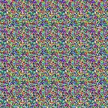

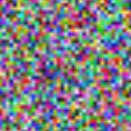
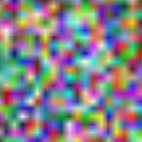
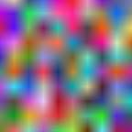



Noise is Smooth Randomness

Slide 209
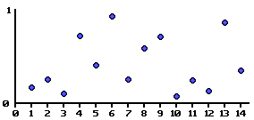
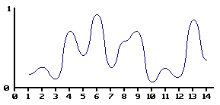
Making Noise
Generate random values at grid points.
Interpolate smoothly between these values.

Slide 210
Linear Noise

Slide 211
lerp
The basic operation of linear interpolation between two values is so commonly used in computer graphics that it is sometimes called a lerp in the jargon of computer graphics.
Lerp operations are built into the hardware of all modern computer graphics processors.

Slide 212
lerping
lerp(v1, v2, t) = (1 – t)v1 + tv2
t of the distance from P to Q
Q
(1-t)P + tQ
P

Slide 213
2D Linear Noise
101 15 182
253 45 3
50 5 241
199 57 20
139 80 230
154 74 178
145 68 37
228 154 219
207 133 174

Slide 214
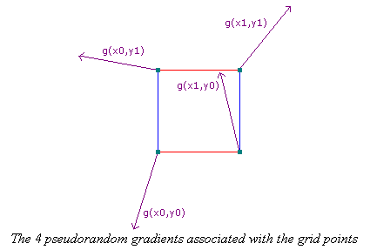
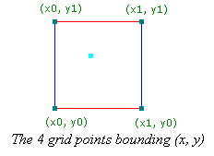
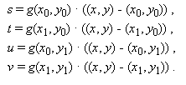


Perlin Noise (2D)
Gradients:
random unit vectors

Slide 215

3D Linear Noise

Slide 216

Perlin Noise Sphere

Slide 217

Turbulence or Sum 1/f(noise)
noise(p) + ½ noise(2p) + ¼ noise(4p) ...

Slide 218

Perlin Sum 1/f(noise) Sphere

Slide 219

Perlin Sum 1/f(|noise|) Sphere

Slide 220







2D Normalized Turbulence
Just Noise

Slide 221







2D Turbulence - Clipped

Slide 222







Marble
factorG = sqrt(abs(sin(x + twist*turbulence(x, y, noise))))
color = (0, trunc(factorG*255), 255);

Slide 223








Clouds
r = sqrt((x-200/d)*(x-200/d) + (y-200/d)*(y-200/d));
factorB = abs(cos(r + fluff*turbulence(x, y, noise));
color=(127 + 128*(1 - factorB), 127 + 128*(1 - factorB), 255);

Slide 224


Perlin’s Clouds and Corona

Slide 225


Perlin Noise in Games
Texture generation
Texture Blending

Slide 226


Animated texture blending
Terrain

Slide 227

Perlin Terrain Example
F.K. Musgrave

Slide 228

Perlin Terrain Example
F.K. Musgrave

Slide 229

Perlin Terrain Example
F.K. Musgrave

